Slide 1
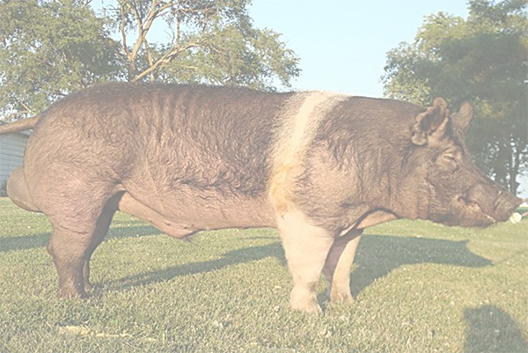
Applied Animal Nutrition
VPP 5431
September 2018

Slide 2
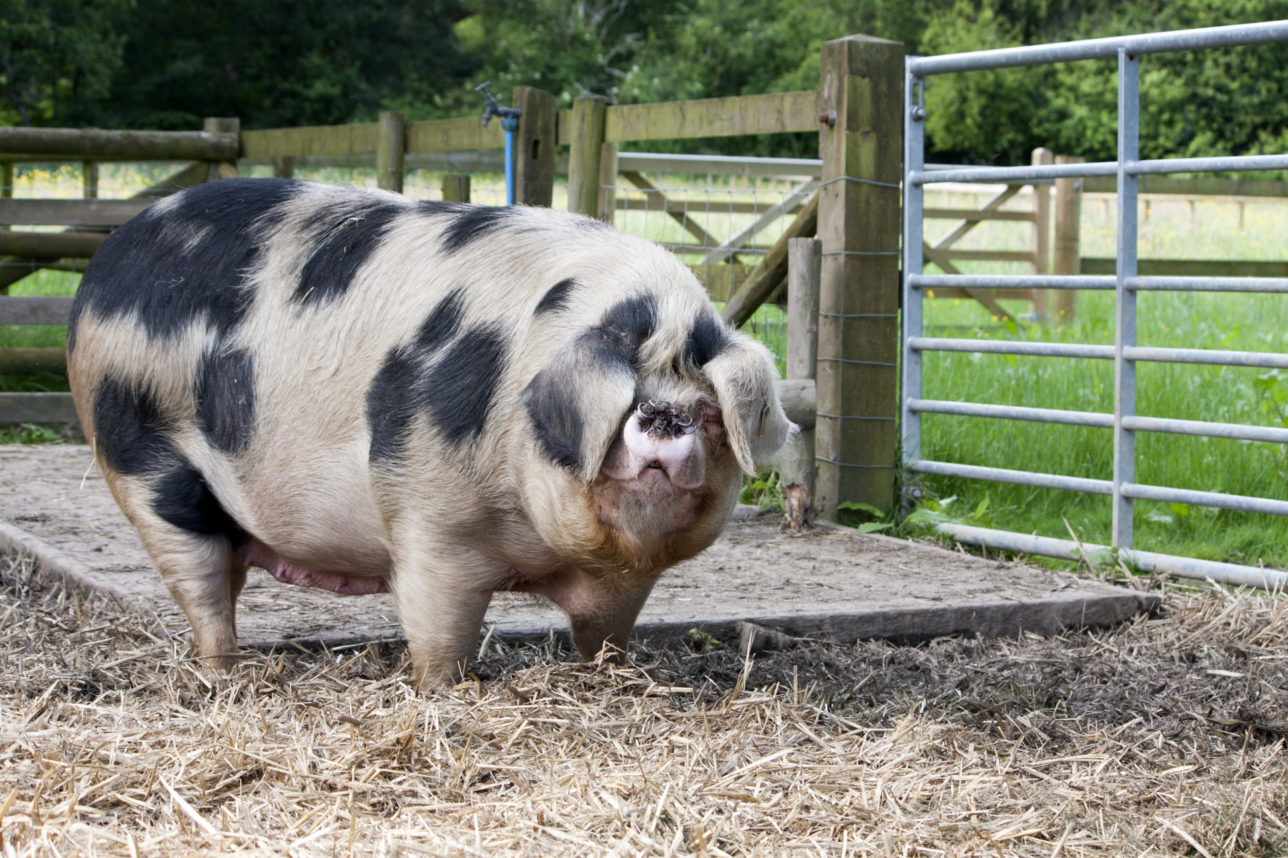
Introduction

Slide 3
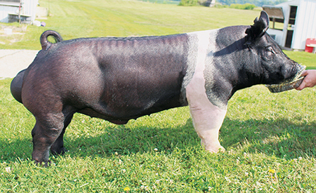
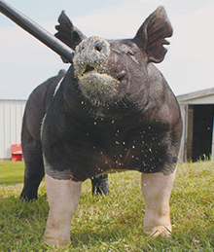
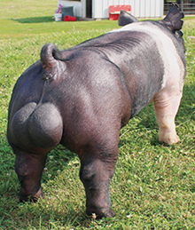
Terminology
BOAR adult intact male

Slide 4
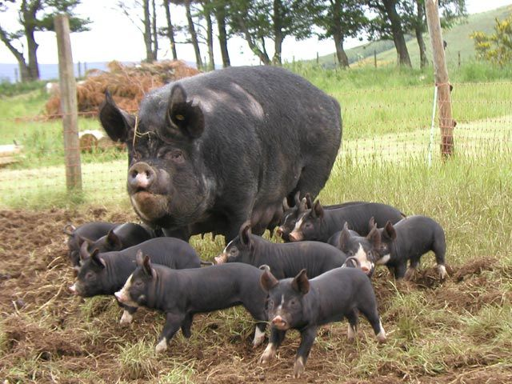
Terminology
SOW adult intact female

Slide 5
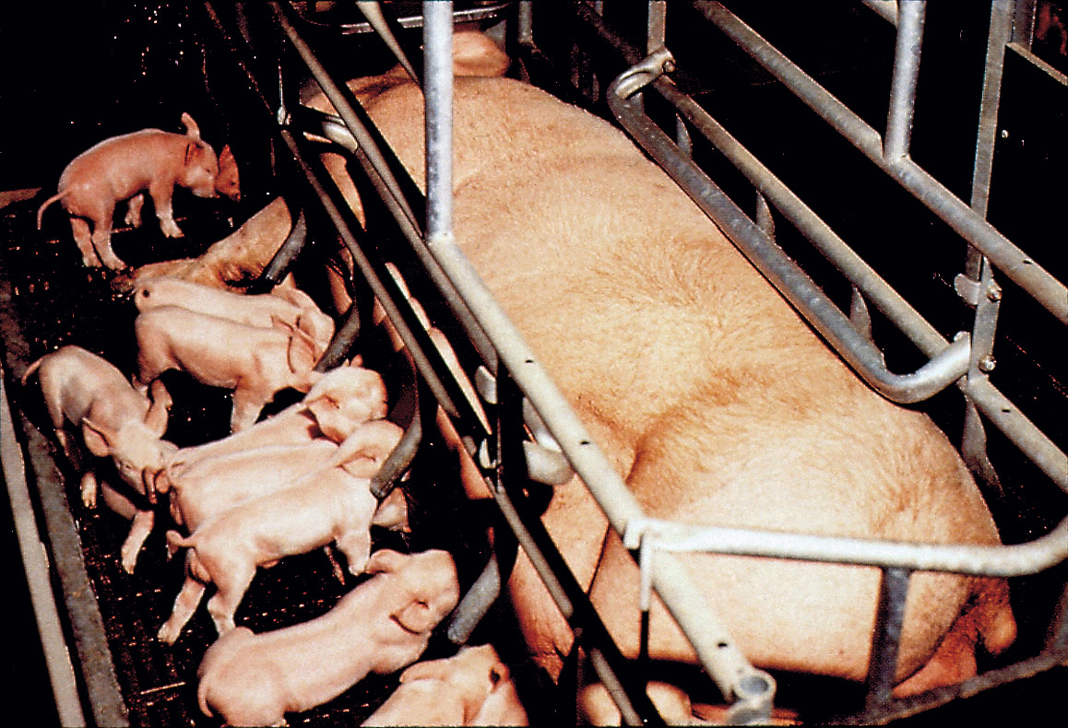
Terminology
Farrowing act of giving birth

Slide 6
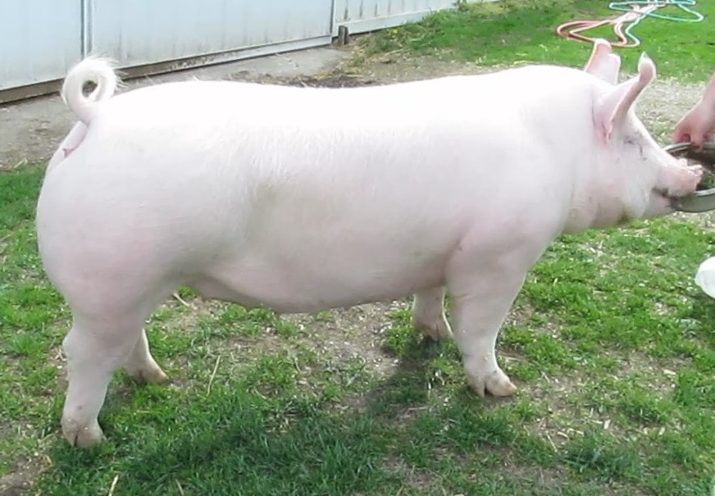
Terminology
GILT young intact female

Slide 7
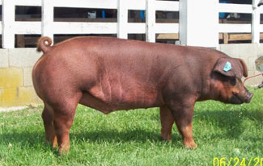
Terminology
BARROW castrated male

Slide 8
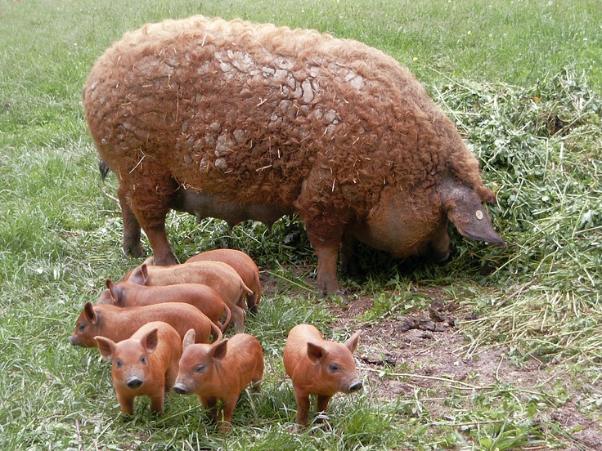
Terminology
piglets

Slide 9
Swine Feeding Guides

Slide 10
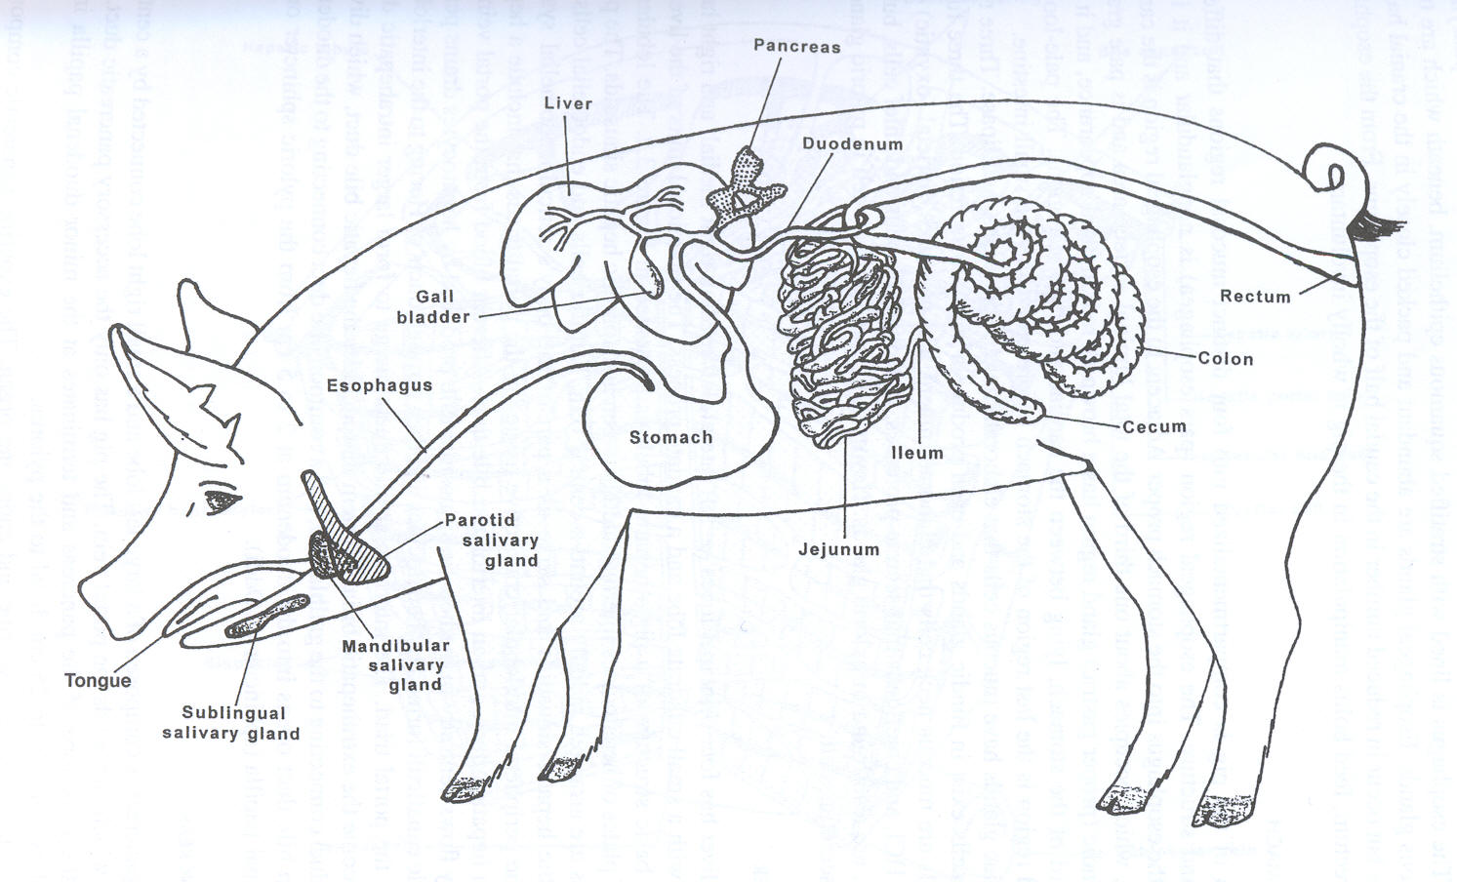
The Pig

Slide 11
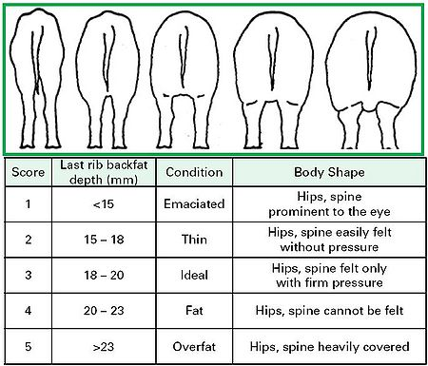

Slide 12
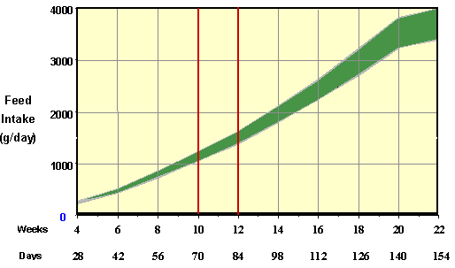
A pig eats approximately 4% of its body weight per day

Slide 13
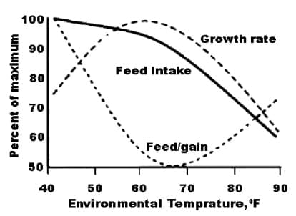

Slide 15
Water
Amount/day
  sow & litter = 8 gal/head/day
  nursery pig = 1 gal/head/day
  grow-finish pigs = 3-4 gal/head/day
Flow rate
  nursery pigs = 2 cups /minute
  grow-finish pigs = 3 cups/minute

Slide 16
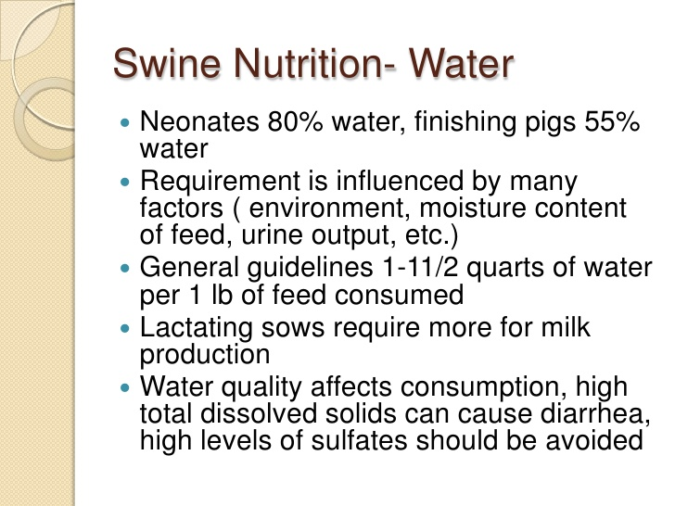

Slide 17
Energy (Lipids)
Second most limiting nutrient to 100 lbs
Pigs need it for all functions
Pigs eat to meet their energy needs!
Main sources are carbohydrates and oils/fats
Energy density of the diet determines level of intake
  high energy diet = reduced intake
  high fiber diet = increased intake

Slide 18
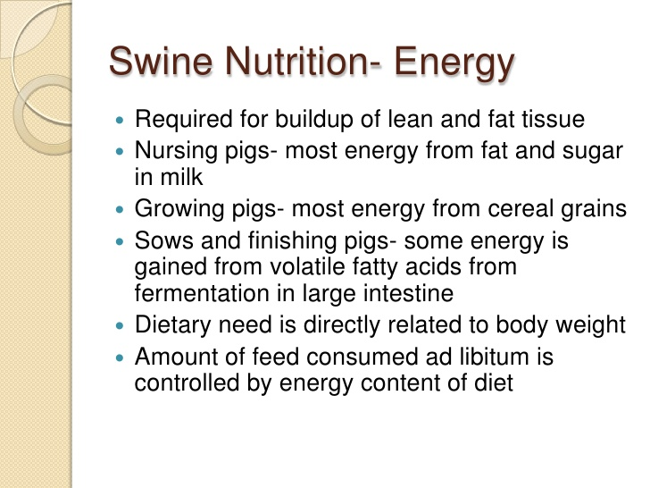

Slide 19
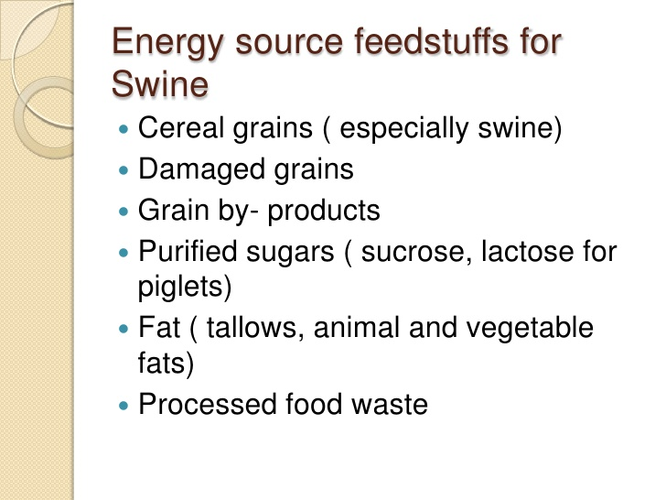

Slide 20
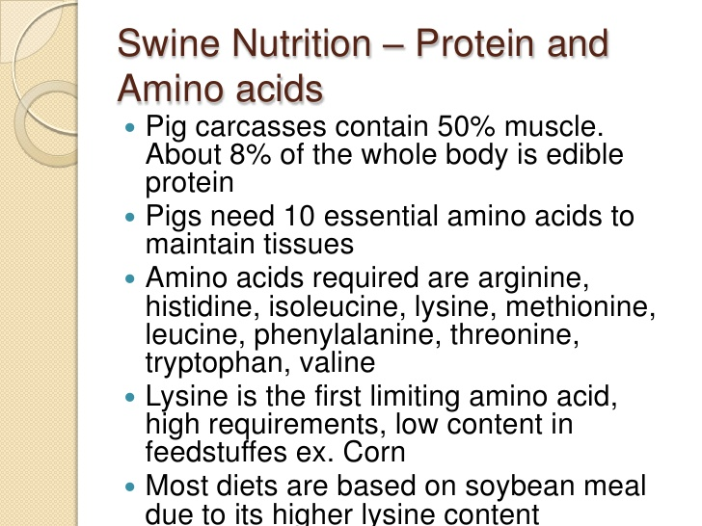

Slide 21
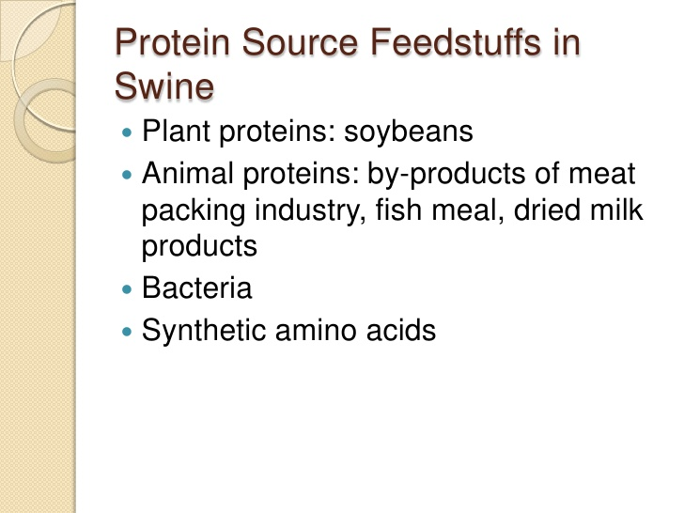

Slide 22
Microminerals
Zinc (Zn)
Manganese (Mn)
Iodine (I)
Iron (Fe)
Copper (Cu)
Selenium (Se)
  Se is a carcinogen but can be in diets up to 0.3 ppm

Slide 23
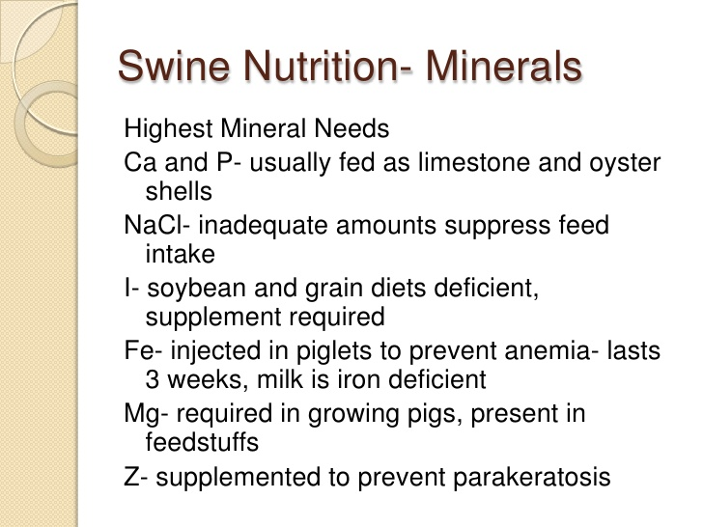

Slide 24
Vitamins
Routinely add to diets
Assume no activity in feedstuffs
2 types of vitamins
  fat soluble
  water soluble

Slide 25
Fat Soluble Vitamins
Vitamin A
Vitamin D3
Vitamin E (tocopherol)
Vitamin K (menadione)
Short shelf-life (3 months)
Negatively affected by heat, light, moisture, and presence of TM
Illegal to store with farm chemicals

Slide 26
Water Soluble Vitamins
Niacin
Pantothenic acid
Vitamin B12
Riboflavin
Choline
Biotin
Folic acid

Slide 27
Vitamins
Source is critical
  Form will affect activity (IU/gram source)
  Acetate forms highest activity
Premixes important here!!
  Mixing very small amounts (5 lbs/ton)
  Premix with SBM

Slide 28
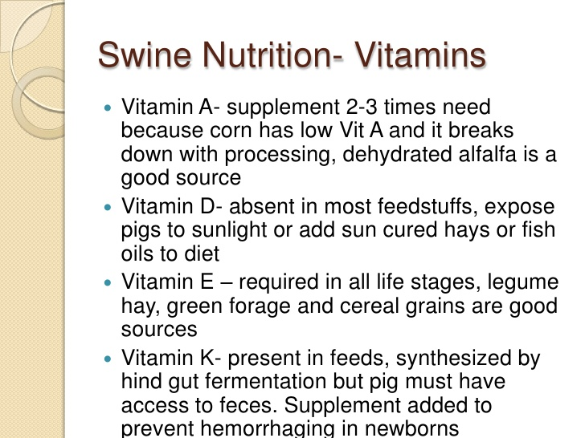

Slide 29
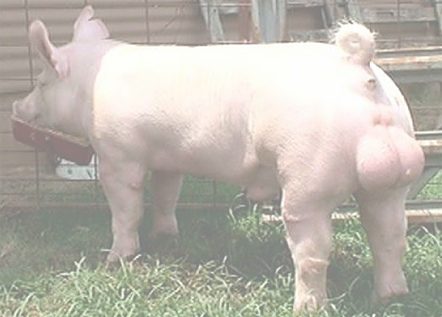
Methods

Slide 30
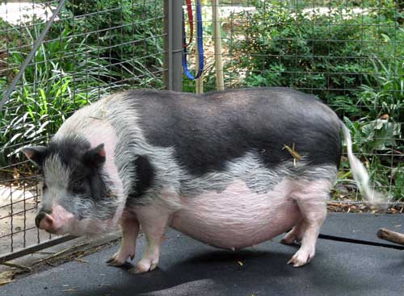
Pet Pigs

Slide 31
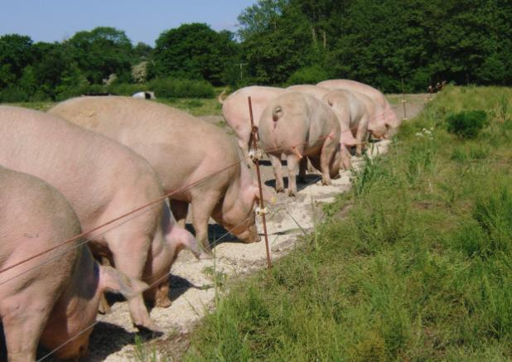
Range Feeding

Slide 32
Video Outdoor Pig Production

Slide 33
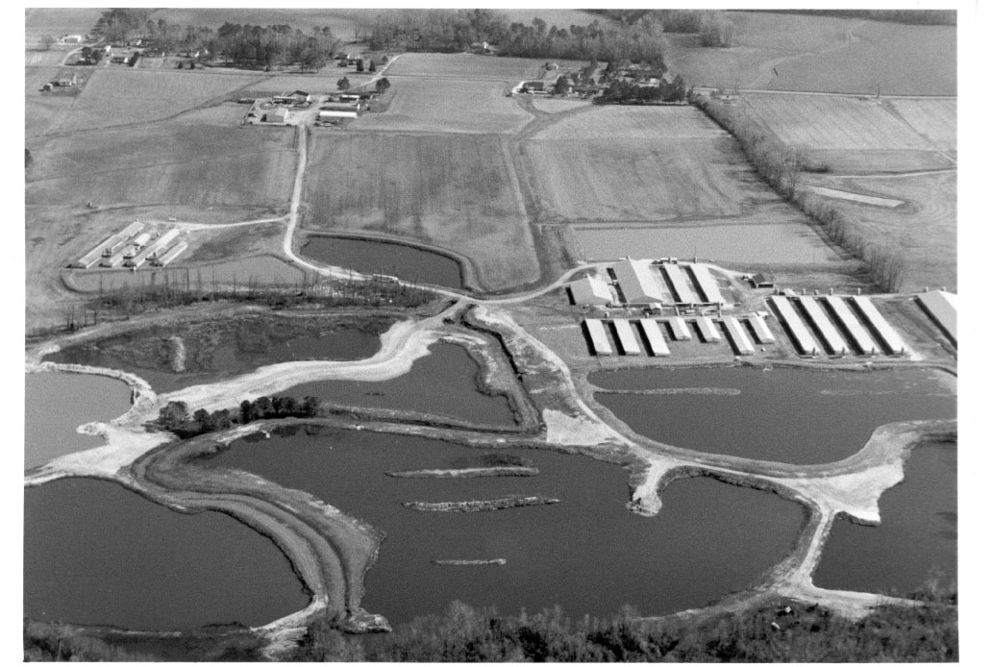
Confinement Feeding

Slide 34
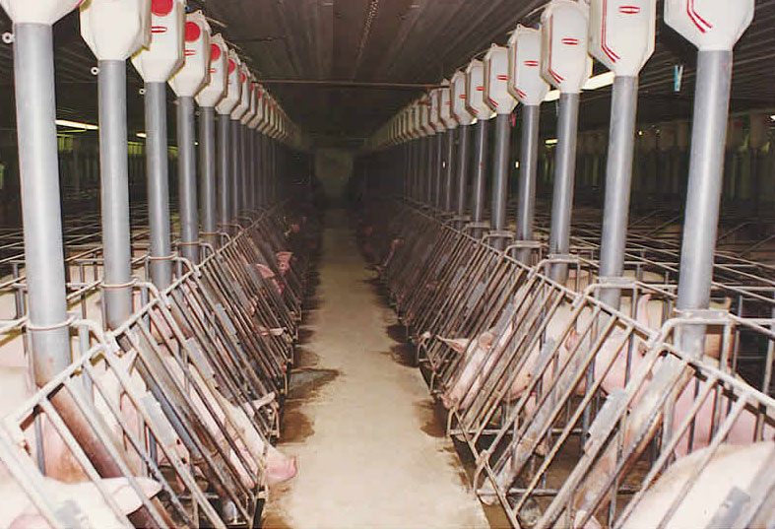
Confinement Feeding

Slide 35
Swine Nutrition through the Lifecycle

Slide 36
Feeding Nursery Pigs

Slide 37
Requirements for piglet starter rations
Make sure that the feed meets the nutritional requirements of the pig
Assure that the feed is highly palatable and digestible
3. The piglet diets should contain bioactive components, such as lactoferrin, mannan-oligosaccharide (MOS), nucleotides and immunoglobulins
4. The feed needs to contain high quality ingredients that ensure the piglets have a good appetite, offer enhanced nutrient digestion and absorption, promote optimal gut health and integrity, and promote optimal performance and economic return.

Slide 38
Feeding the Weaned Pig

Slide 39
Factors affecting Nutrient Requirements
Weaning Age:
  Earlier pigs are weaned, greater need for complex diet to minimize post weaning lag
Antigen Exposure:
  SEW(segregated early weaning)-21% improvement in gain (due to reduced pathogens)
  Effect lasts-19% improvement in gain up to 56 d of age

Slide 40
Factors affecting Nutrient Requirements
Sex and Genotype:
  Gilts have greater growth rate even in nursery
    Gain approx. 5% faster than barrows
    No separate NRC requirements at this age
  Increased lean growth potential
    Higher lysine, P, and B vitamin requirement when compared to NRC recommendations (Stahly et al, Iowa State)

Slide 41
Feeding the Weaned Pig
Phase feeding
  change from requiring energy dense, highly palatable and digestible diet to simple SBM-grain diet by 3-4 weeks post weaning
  Initial complex diet EXPENSIVE
    Eat so little for short period of time, so does not impact overall cost of production

Slide 42
Phase Feeding
Adjusting the ration several times over the grower-finisher period as the nutritional needs of the hog change

Slide 43
Phase Feeding
Starter Rations—focus on the rapid changes in the pig’s digestive system
Starter rations are the most expensive rations because of the ingredients used

Slide 44
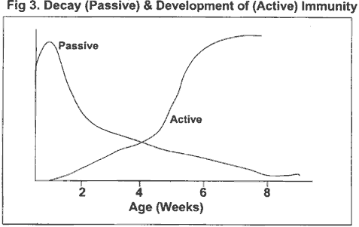

Slide 45
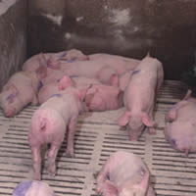
Factors that can limit the potential of the early weaned pig
  Genetics
  Health
  Optimum nutrition through phase feeding

Slide 46
Phase Feeding
Starter Rations—focus on the rapid changes in the pig’s digestive system
Grower Rations—adjusted to sex, age, and genetic potential

Slide 47
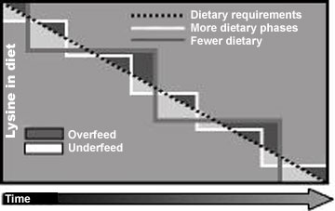

Slide 48
Phase Feeding
Starter Rations—focus on the rapid changes in the pig’s digestive system
Grower Rations—adjusted to sex, age, and genetic potential
Finisher Rations—also adjusted for sex, age, and genetic potential

Slide 49
Feeding Grower-Finisher Pigs

Slide 50
Feeding Growing-Finishing Pigs
30 to 120 kg (nursery to market)
Considered least-complicated segment of swine production
  Newer, leaner genotypes and feeding strategies are changing this perception
75-80% of feed consumed by pigs is during this phase of production

Slide 51
Factors affecting GF Nutrition
Genetics:
  Differ in potential to deposit lean and fat
  Rate and composition of gain affects:
    AA requirement
    Energy needs
  Rapid rate of lean gain ↑ AA needs and ↓ energy needs
    1 kg muscle = 2.23 Mcal
    1 kg fat = 10.3 Mcal

Slide 52
Factors affecting GF Nutrition
Sex:
  Gilts have higher amount of lean gain, larger LEA, and higher % lean carcass
  Gilts are more efficient (consume less feed than barrows)
  Split sex feeding!
  Because barrows consume more feed and deposit less lean—fiber may be incorporated to ↓ energy intake and ↓ fat accumulation

Slide 53
Factors affecting GF Nutrition
Stage of maturity:
  Expressed as daily needs, nutrient requirements increase with age
  BUT, when expressed as % of diet, nutrient requirements decrease as animal ages
    Consuming more feed!!
  Phase feeding will lower feed costs without negatively impacting performance
    Improve nutrient retention
    Less N, P in excreta (↓ pollution)

Slide 54
Factors affecting GF Nutrition
Environmental Temperature:
  Digestion and metabolism generate heat
  This heat can be used to warm the body in cold environments
    Stimulation of FI
  Hot environments will reduce FI
    Supplemental fat!
  Dietary fiber results in more heat generation than do fats/oils

Slide 55
Factors affecting GF Nutrition
Herd Health:
  Hard to quantify, but pigs will gain quicker with higher efficiency when not subject to clinical/subclinical disease
  However, AB should not be used in place of good management practices!

Slide 56
Feeding Developing Gilts
Goal: To optimize reproductive productivity and longevity

Slide 57
Feeding Developing Gilts
Body Condition:
  High culling rate of gilts due to anestrus is highly correlated with low body fat stores
    Due to combined effects of genetic selection for leanness and earlier mating, gilts enter reproductive portion of life with lower fat stores
    >20 mm BF = 46% reaching parity 4
    <14 mm BF = 28% reaching parity 4

Slide 58
Feeding Developing Gilts
Body Condition:
  High culling rate of gilts due to anestrus is highly correlated with low body fat stores
    This does not mean feed your gilts to obesity
    Studies show that a feeding level of 2.5 times maintenance or higher will result in decreased reproductive performance

Slide 59
Feeding Developing Gilts
Locomotor failure:
  12% of females are culled for this reason
  Structural soundness is critical for longevity
  Significantly higher leg disorders were observed in females fed at levels higher than required for maintenance/moderate growth

Slide 60
Feeding Developing Gilts
Practical feeding recommendations:
  Nutrient needs of replacement gilts is similar to that of GF pigs
  Moderate restriction of FI in late finishing/pre-breeding to slow growth seems most prudent
    110-120 kg at mating at second estrus
    Use of low energy (high fiber) ingredients to dilute energy content of diet
  NO recommendation for feeding the replacement gilt
    Too much fat = locomotor problems
    Not enough fat = reduced productivity

Slide 61
Feeding Developing Gilts
Occurrence of Puberty:
  200 to 220 d of age
    Range 102-350 d of age
  Factors affecting:
    Genetic line
    Social environment
    Season
    Boar exposure
    Growth rate
    Body composition
    Age

Slide 62
Feeding Developing Gilts
Occurrence of Puberty:
  2 fold theory:
1. Gilts must achieve a certain body composition before they will exhibit first estrus
    Frisch, 1988 showed girls would not cycle until reaching a certain level of body fatness
    Armstrong and Britt, 1987 reported similar correlation with gilts and BF suggesting cessation and resumption of estrus cycles occur at different body compositions

Slide 63
Feeding Developing Gilts
Occurrence of Puberty:
  2 fold theory:
2. Chronological age affects onset of puberty
    As gilts achieve a certain age they are developed enough to begin cycling
  Most scientists believe onset of puberty is a combination of these 2 theories

Slide 64
Feeding Developing Gilts
Dietary Nutrient Supply & the Occurrence of Puberty:
  Review of literature in 1985 found that severely overfeeding or underfeeding gilts will delay puberty, but to what extent is unclear
  Researchers have reported that restricting protein and/or energy intake from 30-100 kg can delay onset of puberty

Slide 65
Feeding Developing Gilts
Dietary Nutrient Supply & the Occurrence of Puberty:
  Thus it has been suggested that gilts be fed for rapid growth during the rearing period to encourage early expression of pubertal estrus
  Restricting FI after achievement of puberty and establishment of regular estrus cycles may be necessary to prevent gilts from becoming too fat prior to breeding

Slide 66
Feeding Developing Gilts
Nutrition Pre- and Post-Mating:
  Flushing: Offering elevated levels of feed 10 to 14 d before mating to increase the number of ova ovulated
    Response mainly due to increased energy intake rather than protein
    6 Mcal additional ME
    OR 1.8 kg of corn-SBM diet containing 3200 kcal/kg
    OR 1.8 to 2.0 kg cereal grain as top dress to complete diet

Slide 67
Feeding Developing Gilts
Nutrition Pre- and Post-Mating:
  Flushing: Offering elevated levels of feed 10 to 14 d before mating to increase the number of ova ovulated
    Increases ovulation by 2-3 eggs
    May not increase ovulation rate over what is normally expected, but will correct a depression of ovulation rate imposed by dietary restriction
      Since most gilts are restrict fed between puberty and mating

Slide 68
Feeding Developing Gilts
Nutrition Pre- and Post-Mating:
  Ca and P
    Beginning at 45 kg both should be increased 0.1% above typical GF diet to enhance skeletal development
  Post-mating it is critical to return gilt to pre-breeding energy intake
    Prevent high embryo mortality associated with high post-mating FI

Slide 69
The Gestating Female

Slide 70
Gestating Females
Housing system will affect nutritional management
  Group housed sows
    Welfare friendly (↓ stress and ↑ farrowing process)
    Boss sow syndrome: increases variability of weight gain and body condition
      Solution: computerized feeding system
  Individually housed sows
    Increased cost and management
    Each sow can be handled differently
      Eliminates boos sow syndrome

Slide 71
Feeding Strategies
Constant feeding level
  No flexibility to adjust nutrient intake based on BCS
Phase feeding
  Adjust FI of sows to mimic nutrient needs of developing litter in utero
    Demands small first 2/3 of gestation and any changes are to improve BCS of sow
  Fetal growth rate in last trimester increases dramatically
    Sows may catabolize body tissues if maintained on a diet that satisfied their needs in early gestation

Slide 72
Feeding Strategies
Phase feeding
  Caution!
    Excessive sow weight gain during gestation may depress feed intake during lactation
Interval feeding
  Offering feed every other day (every third day, etc.)
  Decreases labor and management
  Works well with sows, not so well with gilts

Slide 73
Metabolic disorders of gestating females
Due to excessive weight gain during gestation
  Gestational diabetes
  Decreases post-farrowing performance
    Low FI
    Increased body protein and fat mobilization
  Decreased milk production
  Farrowing difficulty

Slide 74
Factors affecting Nutrient Requirements
Requirements are determined based on sow body weight
  Metabolic BW = BW0.75
  Energy = 106 ME/kg* BW0.75
  Lys = 36 mg/kg* BW0.75
Environmental temperature
  Above/below thermonuetral zone = ↑ reqts.
  Lower critical temp = 24°C

Slide 75
Factors affecting Nutrient Requirements
Fetal growth/maternal weight gain
  NRC presents requirements based upon anticipated # of piglets in litter and weight gain by the sow during gestation
  Maintenance of sow and growth of fetus are top 2 priorities
    However, sharp increases in energy/protein intake will not affect fetal size or body composition

Slide 76
Food for thought
Too much weight gain
  Dystocia
  Poor feed intake and milk production
Too little weight gain
  Inability to sustain lactation
  Delayed return to estrus and rebreeding
    Anestrus

Slide 77
The Lactating Female

Slide 78
Lactating sows
Most challenging dietary goal of breeding herd
Feed intake capacity during lactation to support nursery progeny = LIMITING FACTOR to milk production
50% of preweaning deaths are related to insufficient milk production

Slide 79
Postfarrowing appetite depression
Parturition is often followed by feed intake depression for several days
  Lethargy
  Limited gut capacity
  Stress of parturition
  EXCESSIVE FAT GAIN during gestation

Slide 80
Maximizing Feed Intake
Again—Phase feeding!
  Sows are provided with gradual and restrictive increase in feed intake the first week of lactation
  Day 1: meet only maintenance requirements.
  Controlled increase will follow until day 5
  Then ad libitum access to feed for the rest of the lactation period

Slide 81
Milk Production
Milk yield peaks between day 15 and 18 of lactation
Milk composition can be altered by diet
  BUT, main factors affecting include:
    Previous nutritional status
    Stage of production
    Diet adequacy

Slide 82
Nutrient Requirements
95% of total body weight change in lactation is loss of protein and fat
Today’s females require more amino acids because they are producing larger litters
However, selection for leanness and increased lean growth has led to reduced capacity for feed intake in sows

Slide 83
Nutrient Requirements
Requirements determined based upon:
  Sow post-farrowing weight
  Anticipated lactational weigh change
  Anticipated daily weight gain of piglets

Slide 84
Nutrient Requirements
Requirements of amino acids are based on ideal protein concept
Energy requirement based upon 4 pools of need:
  Maintenance (106 kcal ME/kg*BW0.75)
  Milk production ((4.92*litter gain)-(90*# pigs))*72%
  Environmental temperature (1°C above/below 20°C subtract/add 310 kcal ME)
  Energy contribution for BW loss (9.4 kcal GE/g fat & 5.6 kcal GE/g protein; assumes 1 kg BW loss = 9.42% protein)

Slide 85
Nutrient Requirements
Mineral Nutrition
  Ca and P: important for sow’s skeletal maintenance as well as for fetus development
  Ca: hypocalcemia will cause poor muscle contraction = poor milk ejection and poor uterine contractions during farrowing
  Mg: Mg salts used as laxatives, but oversupplementation will result in lower Ca absorption

Slide 86
Nutrient Requirements
Mineral Nutrition
  Cr: positive effects on reproductive function
    200 ppb increases litter size
  Se and Vit E: deficiency will increase incidence of decreased milk production

Slide 87
Common feed ingredients
Wide array can be used during gestation due to relatively low energy reqt. compared to other phases of reproductive cycle
Energy = corn, barley, wheat, and sorghum
Protein = SBM
  OR, canola meal, sunflower meal, byproducts of distilling industry

Slide 88
Common feed ingredients
L-lysine used in lactation diets to meet reqt. of high producing sow
WATER: important to maximize milk production
  Deliver 2 L/min from nipple/cup watering systems
FIBER: used to limit energy intake of gestating females and functions as laxative
  ↓ energy intake w/o restricting total feed intake

Slide 89
From Weaning to Rebreeding
Delayed return to estrus = excessive body weight loss
Increased feed intake proven beneficial to ↓ wean to estrus interval
BOTTOM LINE: phases of reproductive cycle are interrelated, what you do in one phase will impact what occurs in the next phase.

Slide 90
Feeding Boars

Slide 91
Boar Nutrition
Very little information
  Due to the fact that boars are a relatively small part of pig population
Reproduction in a boar can be described by 3 characteristics:
  Libido: # of successful mountings (production of ejaculate)
  # sperm cells
  Fertilizing capacity of sperm cells (semen quality)

Slide 92
Replacement Boar Nutrition
Generally fed ad libitum during growing period using protein-adequate diets
After selection period (105 kg or 5-6 mths of age) restricted growth is desired to prevent the boar from becoming too heavy to service females
  Stepwise limitation, not abrupt change

Slide 93
Replacement Boar Nutrition
However, if protein and/or energy is restricted below NRC recommendation in the growing period, the following will be decreased:
  Age at puberty
  BW at puberty
  Semen volume
It does appear unless the males are severely restricted, no lasting effect on reproductive capacity will result

Slide 94
Adult Boar Nutrition: Protein
No positive effects of extra protein on sperm output or on semen quality
  Regardless of mating frequency
In general, protein intake seems to influence libido and semen quantity
  i.e. Low protein (below NRC), low libido/semen quantity

Slide 95
Adult Boar Nutrition: Energy
Culling of boars from commercial swine herds is primarily because they become too heavy
In general, reduced energy intake can negatively affect libido and sperm output, but semen quality is unaffected
  Need to feed approximately 1.5 * maintenance reqt.

Slide 96
Adult Boar Nutrition: Energy
Maintenance reqt. = BW0.75
  Based on sow estimate and thermonuetrality
    Boars should be given 240 kcal ME/d for every degree below 20°C
Growth: no recommendation on ideal growth rate
  Estimated that 7.7 kcal ME/g gain
Reproduction: extra requirement on mating day
  4.3 kcal per kg MBW

Slide 97
Adult Boar Nutrition: Vitamins and Minerals
Vit E: protects against oxidation of FA in semen resulting in higher semen quality
Se: deficiency results in reduced [sperm] and motility
Ca and P: no data on reproductive effects, but required for proper bone maintenance
  For proper libido, sound feet and legs are necessary
  Recommend: 125-200% of NRC req’ments.

Slide 98
Adult Boar Nutrition: Vitamins and Minerals
Biotin: increased requirement when foot problems
  300 to 1000 µg/kg biotin
Vit A: 600 mg/d improves motility when semen is stored
Zn:
  Deficiency in young males results in lack of ability to attain reproductive function
  In adult males, low Zn results in reduced sperm quantity and quality

Slide 99
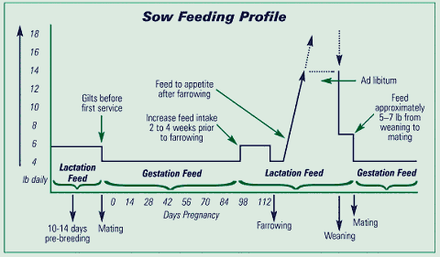

Slide 100
Problems
Anemia

Slide 101
Problems
Anemia
Vitamin Deficiencies

Slide 102
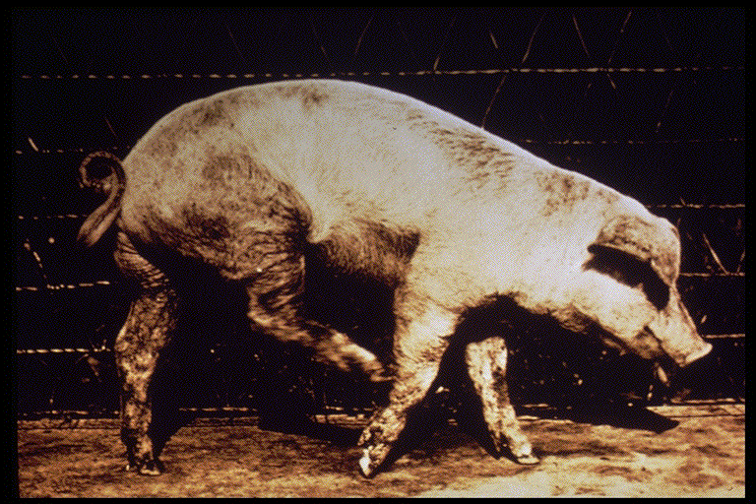
Problems
Vitamin Deficiencies—the substance present in the least amount relative to demand will limit the metabolic process
Photo courtesy of Irlbeck (CSU)

Slide 103
Problems
Anemia
Vitamin Deficiencies
Minerals

Slide 104
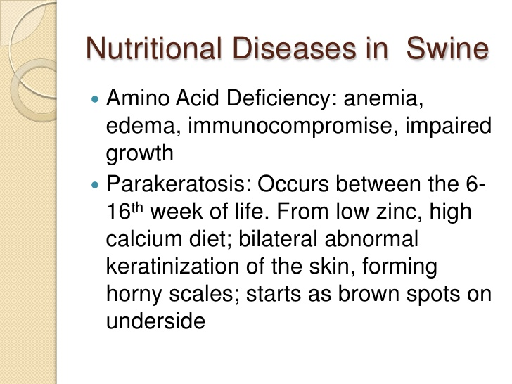

Slide 105
The ratio of calcium to phosphorus is important to ensure optimum performance. You should strive for a ratio in the range of 1.2 to 1.0 or an available phosphorus based-ratio of 2:1 or 3:1. A wide Ca:P ratio (excess Ca of 25 percent or more) will lower the phosphorus absorption, resulting in reduced growth, and structural unsoundness (poor bone calcification). The ratio is less critical if there is excess P in the diet. However, a narrow Ca:P ratio will result in a more efficient use of phosphorus and will be more economically feasible.

Slide 106
Problems
Anemia
Vitamin Deficiencies
Minerals
Essential amino acids

Slide 107
Problems
Anemia
Vitamin Deficiencies
Minerals
Essential amino acids
Essential fatty acid

Slide 108
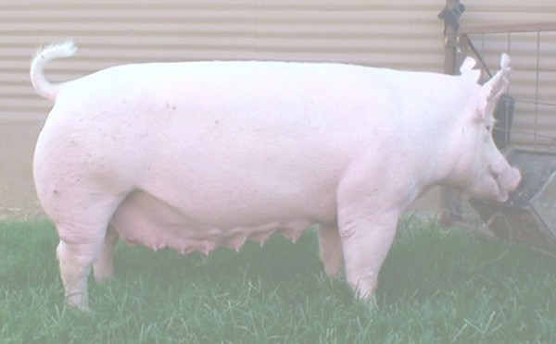
Energy

Slide 109
Miscellaneous Topics
Vitamin E supplementation has been shown to prolong shelf-life of meat and improve color appeal to consumers.

Slide 110
Miscellaneous Topics
Palatability enhancers

Slide 111
Miscellaneous Topics
Supplemental enzymes
Phytase—an enzyme that can break down the undigestible phytic acid (phytate) part found in grains and oil seeds and thus release digestible phosphorus calcium and other nutrients.

Slide 112
Miscellaneous Topics
Conjugated linoleic acid

Slide 113
Miscellaneous Topics
Dietary Fiber—may beneficially affect the host by selectively stimulating the growth and/or activity of one or a limited number of health-promoting bacteria in the intestinal tract thus improving the hosts intestinal physiology

Slide 114
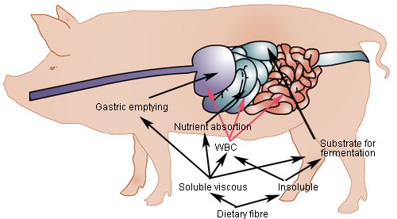

Slide 115
Miscellaneous Topics
A healthy diet needs to contain compounds that are not digestible by the host, but can be metabolized by some gastro-intestinal bacteria, preferably lactic acid producing bacteria

Slide 116
Miscellaneous Topics
Increasing carcass lean content
  Restricted feeding
  Porcine somatotrophin
  Beta agonists (Ractopamine)
  Transgenic pigs

Slide 117
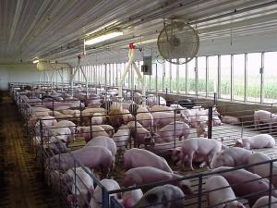
Ractopamine in feed for animals is responsible for dramatic muscle growth, yet it is not a steroid or hormone, but rather a compound known as a beta agonist. Only a trace amount of ractopamine need be added for a marked increase in protein and decrease in fat accretion in animals, in particular swine. For the last 90 pounds of live weight gain, a mere 18.5 grams of ractopamine added to a ton of feed (20 ppm) will increase protein by 24% and decrease fat by 34%.[3]

