Slide 1
Drug Use, Misuse and Residues

Slide 2
Learning objectives
Know advantages and disadvantages of food animal antibiotics
Be able correctly apply extra-label drug use (ELDU) rules in food animals
Know which drugs are banned in food animals and why
Know the tools available for antibiotic residue avoidance
Correctly select an appropriate drug for the situation

Slide 3
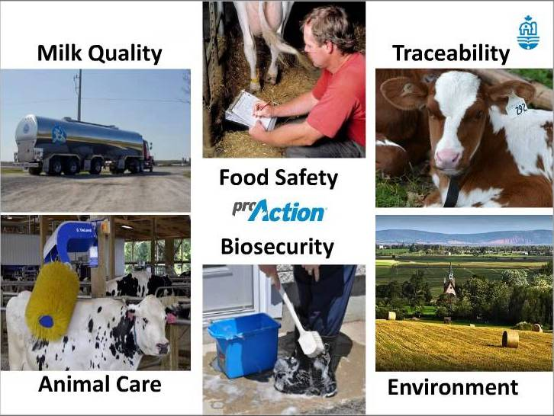

Slide 4
Terminology
OTC……over the counter
Prescription
ELUD or ELDU…….extra label use drug or drug usage
VCPR…….veterinary client patient relationship

Slide 5
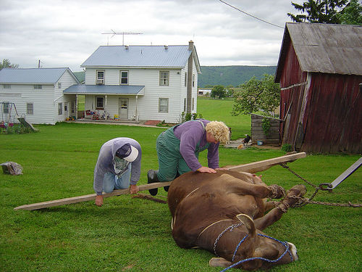
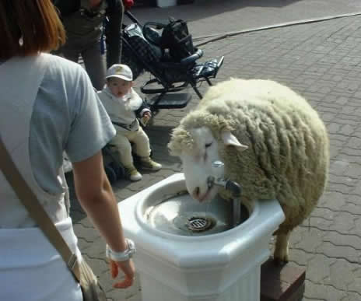
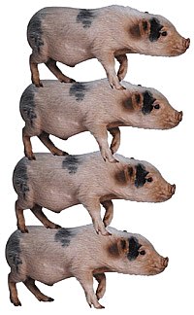
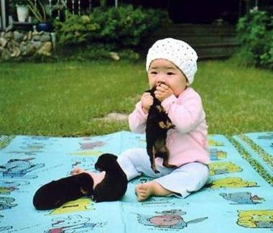
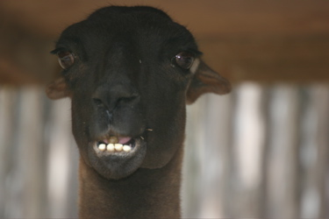
What is a Food Animal?
Dairy cow, beef cow, sheep, pigs, goats
Pet cow?
Yes, pets are still considered FA according to government.
Pet goat
Yes
Potbellied pig
Yes
Llama
No
Horse
No

Slide 6
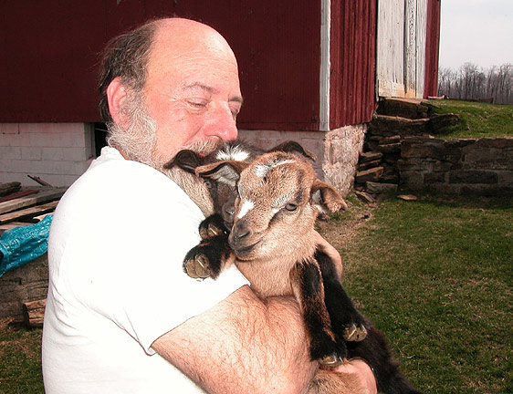
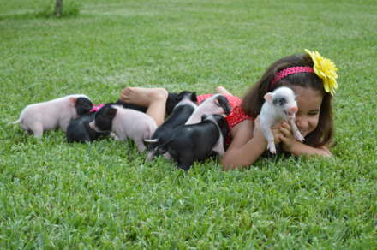
Pet goat
Will never go into the food chain….
People die
Goats get sold
Pot bellies get
  eaten.

Slide 7
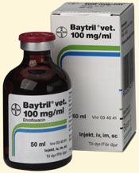
Potbellied pig treated with Baytril
FDA response:
  Potbellied pigs considered FA
  Food animals are those species from which edible tissues are consumed by people in this country.
  FDA can change the status of a non-food animal species to a food animal species when believed that they are regularly consumed.
Baytril: Federal law prohibits the extra-label use of this drug in food-producing animals.
Indicated for the treatment of bovine or swine respiratory disease associated with certain pathogens.

Slide 8
Potbellies might go to slaughter
ONCE POPULAR AS PETS, POTBELLIED PIGS ARE NOW A NATIONAL PROBLEM
COLUMBUS, Ohio -- In the last decade, Vietnamese potbellied pigs have reached the height of their popularity as exotic household pets in the United States.
But a new study suggests the novelty has worn off, and some owners are trying to get rid of the pets because they are too big, too aggressive or illegal in their communities. And stray pigs have become a surprising problem in some areas.
A survey of 802 humane organizations in seven states found that they received 4,380 requests to accept potbellied pigs during a recent 18-month period. They accepted 72 percent of these pigs.
However, not all unwanted pigs are going to humane societies. The study also found that 485 slaughter houses received 4,047 requests to slaughter potbellied pigs during the same period.

Slide 9
Drug Use in Food Animals
AMDUCA Animal Medicinal Drug Use Clarification Act
OTC, Prescription, ELUD
For ELUD
  Valid veterinarian/client/patient relationship (VCPR)
  No labeled drug alternative available
  Adequate records are kept by veterinarian and client
  Significantly prolonged withdrawal times
  Properly labeled by veterinarian
No extra-label privilege for feed additives
https://www.avma.org/KB/Resources/FAQs/Pages/ELDU-and-AMDUCA-FAQs.aspx

Slide 10
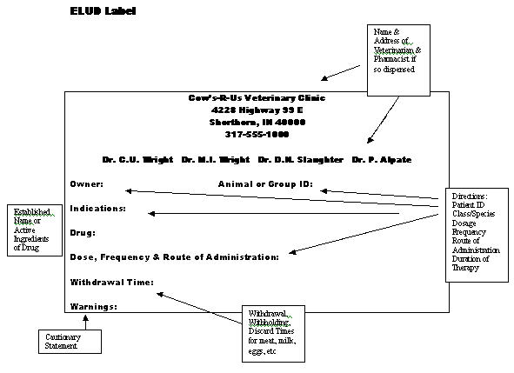

Slide 11
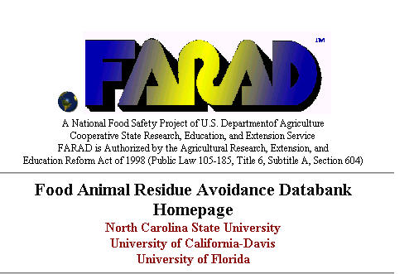

Slide 12
Milk and Dairy Beef Residue Prevention Protocol
Practice Healthy Herd Management
Establish a Valid VCPR
Use Only FDA Approved OTC or Prescription Drugs
Label Correctly
Store Drugs Correctly
Administer Drugs Correctly and Identify Treated Animals
Maintain Treatment Records
Use Drug Residue Screening Tests
Implement Employee/Family Awareness
Complete Protocol Annually

Slide 13
The Market for Swine Drugs
Growth promotants ( e.g.lincomycin, tylosin, virginiamycin)
GI Disease, particularly nursery pigs
Respiratory Disease, (tetracyclines, Pulmotil)
Ileitis (tylosin, lincomycin)
Atrophic Rhinitis
External and Internal Parasites

Slide 14
What Drives the Market for Cattle Drugs?
Respiratory Disease
Parasitism
Reproduction
Mastitis
Production enhancement
  BST
  Bovatec/Rumensin
Notes:
Feed additive antibiotics have gone away from dairyb ut nutritional supplements (biotin, choline, amino acids) are a developing market

Slide 15
Special features of the dairy cow
Product sold daily
Intense product surveillance and regulation
Milk contains fat
Special health issues of milking cows
  Metabolic disease
  Mastitis
  Reproductive (infectious and hormonal)
  Infectious foot conditions

Slide 16
Potential risks to humans from drug residues
Direct poisoning by drug residue
  Toxicity
  Pharmacologic effect
Cancer
Mutations
Change gut bacteria
Bacterial drug resistance
Allergy
Effects on food processing
Notes:
Example: chloramphenicol – non dose dependent toxic effect – some chloramphenicol just the trigger. Dihydrostreptomycin causes optic neuritis and other neuropathies
Perturbation of human gut flora: eg gut bacteria metabolize digoxin, but if patient treated with tetracycline or erythromycin digoxin levels in blood rise by up to 100% leading to digitalis toxicity. Not proven at subtherapeutic doses
B agonist clenbuterol has pharmacologic effect (particularly concentrated in liver)
Mention allergy here as not mentioned elsewhere in talk. Copuld trigger a response in people already allergic, but not likely to induce allergic state themselves. One case of a 14 y.o girl (sensitive to streptomycin) who had anaphylactic reactions after eating beef on 4 occasions. Not proven. But 58% of patients with hives as a result of penicillin allergy had remission of symptoms when taken off milk.
Penicillin resistant organisms pre-date the discovery of penicillin by Fleming 60 years ago.
Penicillin G particular culprit in manufacturing loss – penicillin residue avoidance started because of economic loss not human health risk.

Slide 17
Illegal Drugs
Drugs banned from use in dairy animals
  Sulfamethazine (except under 20 months)
  Other sulfonamides (esp. sustained release products)
  Tetracyclines as feed additives
    But now labeled for dairy as therapeutic drug eg LA-200
Notes:
and excretion is complex so some sulfas are approved eg Albon (sulfadimethoxine)
Tetracyclines bind to calcium (in milk or teeth)

Slide 18
Illegal Drugs
Banned in any food animal
  Chloramphenicol
  Clenbuterol (Ventipulmin)
  Diethylstilbestrol (DES)
  Dimetridazole
  Ipronidazole
  Other nitroimidazoles (e.g. metronidazole (Flagyl))
Notes:
Nitroimidazoles – mutagens and potential carcinogens
Estradiol withdrawn from the market – no labeled indication. To use it would have to manufacture from bulk ingredients, which would be illegal.

Slide 19
Illegal drugs
Banned in any food animal
  Furazolidone
  Nitrofurazone
  Fluoroquinolones (e.g. Baytril, A180) except approved use
  Glycopeptides (e.g. Vancomycin)
  Dipyrone (Metamizole)
  Phenylbutazone (dairy >20mths)
Notes:
Furazolidone although blood levels fall rapidly – some metabolites seem to be more or less permanently bound.
Furazolidone Aerosol (Topazone)and Nitrurazone Topical Powder (NFZ) – residues found by ocular route using C-14 tracing. Can cause cardiomyopathies.
Dipyrone rapidly metabolized and excreted – not a residue problem. Was withdrwn from human use because of toxic side effects in the seventies. Competitor for Banamine.
Nitrofurans carcinogenic (ovarian cancer in rats) and mutagenic
Sarafloxacin approval withdrawn in 2000 over worries over Campylobacter in humans. Ciprofloxacin is a metabaolite of enrofloxacin

Slide 20
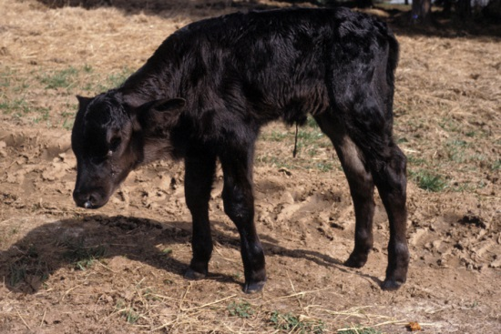
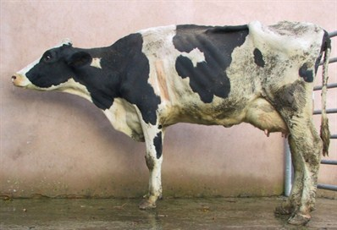
Illegal or Not
Ceftiofur for treatment of calf septicemia.
There are no drugs approved for septicemia.
Prohibited to use ceftiofur EL, EXCEPT for indications.
Not illegal
Enrofloxacin for treatment of respiratory disease in a dairy cow.
Extralabel use of fluoroquinolones is illegal.

Slide 21
FLU-NIX™ D (IVX) AgriLabs
Flunixin Meglumine Injection 50 mg/mL
For IV or IM use in Horses and for IV use in Beef and Dairy Cattle. Not for Use in Dry Dairy Cows and Veal Calves.
CAUTION Federal law restricts this drug to use by or on the order of a licensed veterinarian.
INDICATIONS Cattle: indicated for the control of pyrexia associated with bovine respiratory disease and endotoxemia. Flu-Nix™ D is also indicated for the control of inflammation in endotoxemia.
DOSE AND ADMINISTRATION: Cattle: The recommended dose for control of pyrexia associated with bovine respiratory disease and endotoxemia and control of inflammation in endotoxemia is 1.1 to 2.2 mg/kg (0.5 to 1 mg/lb; 1 to 2 mL per 100 lbs) given slow IV SID or divided into two doses BID for up to 3 days.
RESIDUE WARNINGS: Cattle must not be slaughtered for human consumption within 4 days of the last treatment. Milk that has been taken during treatment and for 36 hours after the last treatment must not be used for food. Not for use in dry dairy cows. A withdrawal period has not been established for this product in preruminating calves. Do not use in calves to be processed for veal.

Slide 22
Extralabel
Does not necessarily mean illegal
Based on veterinarian discretion
Need to alter the withdrawal periods based on extralabel usage.
Example: Penicillin, dosed at 4.5 ml per 100 lb. The label says 1 ml per 100 lb. This is NOT illegal, simply extralabel.

Slide 23
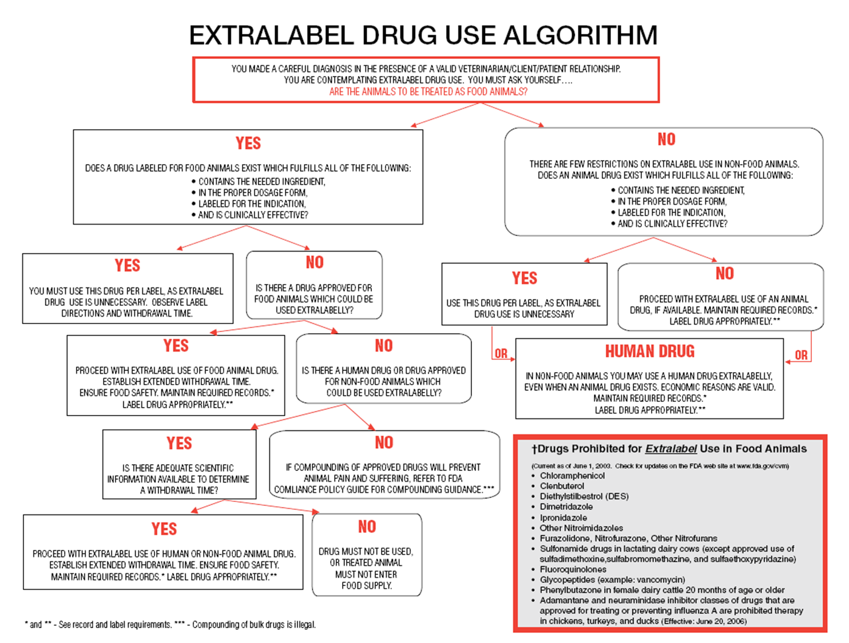

Slide 24
Extralabel: Legal/Illegal
If the label, specifically says that use of this drug in an extralabel manner is prohibited….its is illegal.
Example: Phenylbutazone in female dairy cattle 20 months of age or older is illegal but would be legal in a 19 mo old Holstein heifer.
http://www.fda.gov/AnimalVeterinary/ResourcesforYou/ucm380135.htm#Drugs_Prohibited_from_Extra-Label_Uses_in_Animals

Slide 25
Extralabel or label: Completely illegal
There are some drugs that are totally prohibited from food animal use.
Example: Chloramphenicol
No food animal species is on the label, thus any use would be illegal.

Slide 26
Concerns over Antibiotic Use
Fluoroquinolones
Naxcel and Excenel
Cefazolin
Gentamicin (Gentocin)
On farm decision-making
Injectables vs intramammary for mastitis treatment
Extended antibiotic therapy for mastitis
Multiple use bottles for intramammary
Medicated milk replacer – veal - neomycin
Notes:
Baytril situation
Misuse for mastitis of Naxcel
Withdrawal periods cf Pirsue in Britain

Slide 27
Other drug issues
European ban on hormonal growth promotants (Precautionary Principle)
  Estradiol, progesterone, testosterone
  Trenbolone, zeranol (Ralgro), melengestrol acetate
Minor Use, Minor Species Act, 2004 (MUMS) (e.g.repro. drugs for sheep)
  conditional approval,
  index of legal marketed unapproved animal drugs
  orphan drugs
Notes:
Conditional Approval: Under MUMS, the sponsor of a veterinary drug can ask CVM for “conditional approval,” which allows the sponsor to make the drug available before collecting all necessary effectiveness data, but after proving the drug is safe. The drug sponsor can keep the product on the market for up to five years, through annual renewals, while collecting the required effectiveness data.
Indexing: In some cases, the potential market for a minor species drug is just too small to ever support the costs of the drug approval process, even under a conditional approval. In such cases, FDA now may add the drug to an index of legally marketed unapproved new animal drugs. This provision will be especially helpful to veterinarians treating zoo or endangered animals or classes of animals that i nc lude several different species, such as ornamental fish.
Designation: This aspect of the legislation is similar to the “Orphan Drug Act” for humans, which helps pharmaceutical firms develop drugs for limited human uses. It provides i nc entives for approval. Grants to support safety and effectiveness testing will be available. Companies who gain approval for designated new animal drugs will be granted seven years of marketing exclusivity, which means the sponsor will face no competition in the marketplace for that use of the drug for that time.
CIDR-g in sheep, florfenicol in sheep, licomycin for foul brood in bees, erythromycin in salmon
Renbolon = Synovex

Slide 28
To date, the ELDU of the following drugs has been prohibited in food-producing animals, regardless of whether or not the criteria for ELDU are met:
Chloramphenicol;
Clenbuterol;
Diethylstilbestrol (DES);
Dimetridazole;
Ipronidazole;
Other nitroimidazoles;
Furazolidone;
Nitrofurazone;
Sulfonamide drugs in lactating dairy cattle (except approved use of sulfadimethoxine, sulfabromomethazine, and sulfaethoxypyridazine);
Fluoroquinolones;
Glycopeptides;
Phenylbutazone in female dairy cattle 20 months of age or older.
Cephalosporin (excluding cephapirin) use in cattle, swine, chickens and turkeys:
  Using cephalosporin drugs at unapproved dose levels, frequencies, durations or routes of administration is prohibited
  Using cephalosporin drugs in cattle, swine, chickens or turkeys that are not approved for use in that species (e.g., cephalosporin drugs intended for humans or companion animals);
  Using cephalosporin drugs for disease prevention

Slide 29
The following drugs, or classes of drugs, approved for treating or preventing influenza A in humans, are prohibited from ELDU in chickens, turkeys, and ducks regardless of whether or not ELDU criteria are met:
Adamantanes;
Neuraminidase inhibitors.
Extralabel use of drugs in treating food-producing animals for improving rate of weight gain, feed efficiency, or other production purposes is prohibited under AMDUCA.
No extralabel uses in animal feed are allowed.

Slide 30
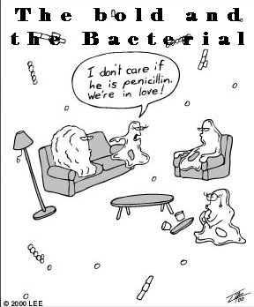
Choosing an antimicrobial
Penicillin (Procaine P G; Polyflex [amoxicillin]; Benzathine Pen), K-pen (IV)
PPG
Gram-positive spectrum
Daily dosing
Medium withdrawal times (10 days)
Cheap
OTC
Example use: footrot, presurgical, Listeria, Clostridial infections

Slide 31

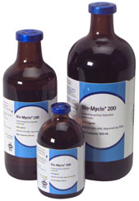
Choosing an antimicrobial
Oxytetracycline (100, 200, 300 mg/ml; Chlortetracycline)
LA (long acting) 200
Broad spectrum
Bacteriostatic
Thick solution
Injection reactions
1-3 day dosing interval (100-200 mg)
7 day interval (300 mg)
Cheap
OTC

Slide 32
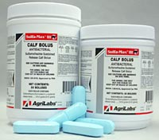
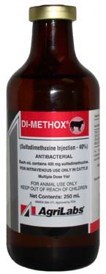
Choosing an antimicrobial
Sulfas (Albon, sulfa boluses)
Sulfadimethoxine
Broad spectrum
Bolus or injection
Cheap
Extralabel use illegal in dairy cattle > 20 mo.
1-3 day dosing intervals
OTC

Slide 33
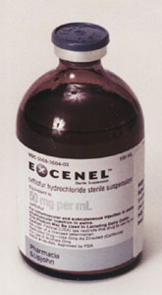
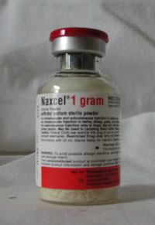
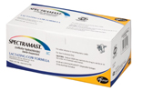
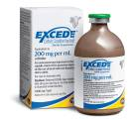
Choosing an antimicrobial
Cephalosporins (ceftiofur sodium, Naxcel and ceftiofur HCl, Excenel and Excede)
Naxcel
Broad spectrum: more Gram Negative
Moderate cost
Short withdrawal times
Daily dosing (except Excede ~ 7 d)
Small volume of dose

Slide 34
Ceftiofur update
Extralabel use prohibited except for indications (extralabel OK for Small Ruminants)
Naxcel, Excenel and Excede
All labeled for (except intramammary):
  BRD
    Mannheimia
    Pasteurella
    Histophilus
Excenel labeled for:
  Footrot
  Metritis
Naxcel (Bo, Po, Ov, Cap)
  Bo: footrot and BRD only

Slide 35
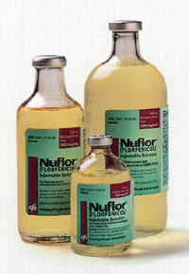
Choosing an antimicrobial
Florfenicol (Nuflor)
Broad spectrum
Static
Fairly expensive
Dosing 2 or 4 days
Thick

Slide 36
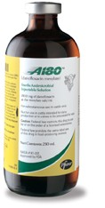
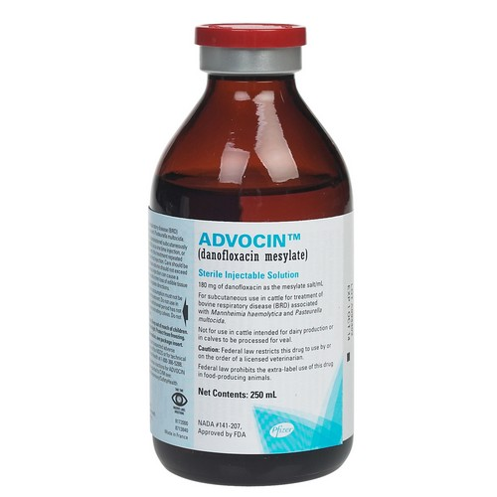
Choosing an antimicrobial
Enrofloxacin (Baytril)
Danofloxacin (A180)
Broad spectrum
Expensive
1-2 day dosing interval
Extralabel use illegal
4 d
Meat
withdrawal
28 d
Meat
withdrawal

Slide 37
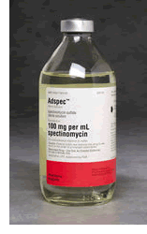
Choosing an antimicrobial
Spectinomycin (Spectam)
Erythromycin
Tylosin
Less common use
Cheap
Spectam for bovine resp. dz
Tylosin sheep and swine diseases
Erythromycin???

Slide 38
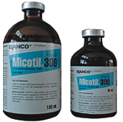
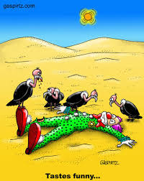
Choosing an antimicrobial
Tilmicosin (Micotil)
For bovine resp dz
Seminal vesiculitis
3 day dosing interval
Fatal injections
Moderate expense

Slide 39
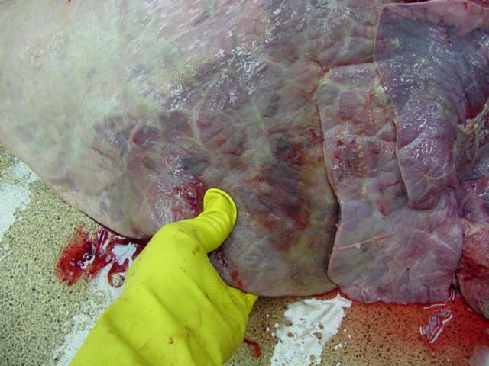
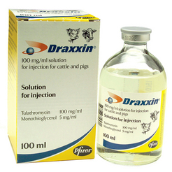
Draxxin: Relatively New Antibiotic
Tulathromycin (erythromycin cousin)
Not labeled for female dairy cattle > 20 months
dose 1 ml /88 lbs
cattle and swine
SQ cattle; IM swine
In cattle: labeled for bacterial respiratory disease
One shot last ~7 days

Slide 40
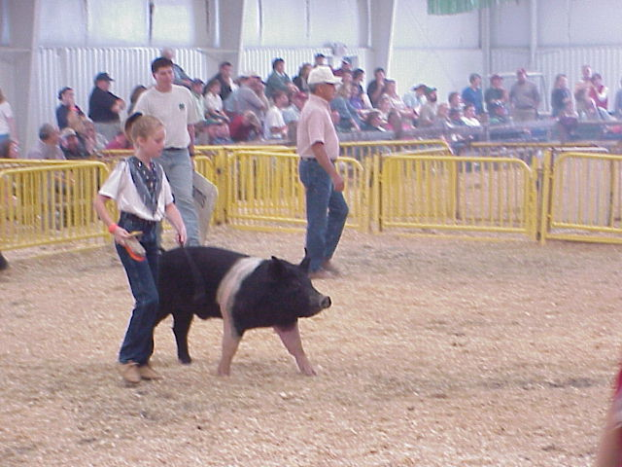
Draxxin: New Antibiotic
In swine: labeled for swine respiratory disease (A. pleuropneumoniae, P. multocida, Bordetella, Hemophilus parasuis)
Meat w/d: 18 days cattle; swine is 5 days
Single dose

Slide 41
https://pubs.ext.vt.edu/400/400-008/Table_1.html
https://www.zoetisus.com/products/pages/draxxin_index/index.aspx
http://usa.zuprevo.com/cattle/
https://www.uky.edu/Ag/AnimalSciences/goats/presentations/A5%20Goatmeds%5B1%5D.pdf
http://www.sheep101.info/201/drugs.html

Slide 42
Useful references
Pork Quality Assurance
  www.porkboard.org
Milk and Dairy Beef Residue Prevention
  www.DQAcenter.org
FDA Center for Veterinary Medicine
  www.fda.gov/cvm/
Drug Residues in Foods, Botsoglou NA, Fletouris DJ, Marcel Dekker 2001
  615.594 B658d 2001

