Slide 1
Drug Use, Misuse and Residues
Dr. Simon Kenyon

Slide 2
Drug Use in Food Animals AMDUCA Animal Medicinal Drug Use Clarification Act
OTC, Prescription, ELUD
For ELUD
Valid veterinarian/client/patient relationship (VCPR)
No labeled drug alternative available
Adequate records are kept by veterinarian and client
Significantly prolonged withdrawal times
Properly labeled by veterinarian
No extra-label privilege for feed additives

Slide 3
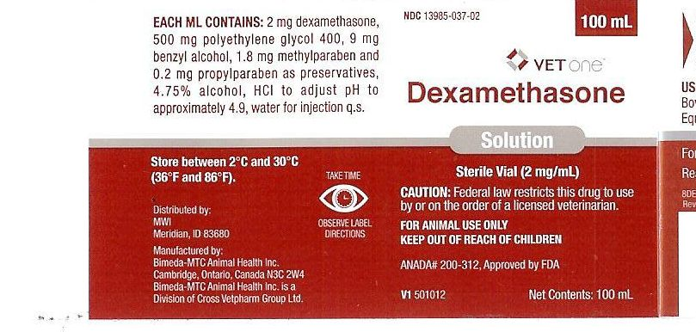
Prescription Drug Label

Slide 4
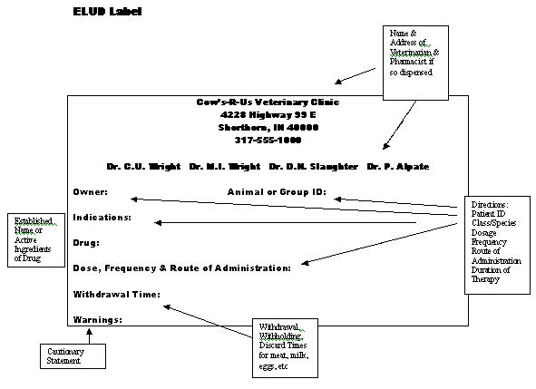

Slide 5
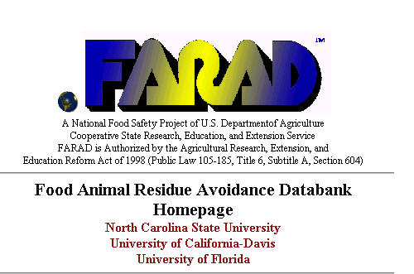

Slide 6
The Market for Swine Drugs
Growth promotants ( e.g.lincomycin, tylosin, virginiamycin)
GI Disease, particularly nursery pigs
Respiratory Disease, (tetracyclines, Pulmotil)
Ileitis (tylosin, lincomycin)
Atrophic Rhinitis
External and Internal Parasites

Slide 7
What Drives the Market for Cattle Drugs?
Respiratory Disease
Parasitism
Reproduction
Mastitis
Production enhancement
BST
Bovatec/Rumensin
Notes:
Feed additive antibiotics have gone away from dairy but nutritional supplements (biotin, choline, amino acids) are a developing market

Slide 8
Potential risks to humans from drug residues
Direct poisoning by drug residue
Toxicity
Pharmacologic effect
Cancer
Mutations
Change gut bacteria
Bacterial drug resistance
Allergy
Effects on food processing
Notes:
Example: chloramphenicol – non dose dependent toxic effect – some chloramphenicol just the trigger. Dihydrostreptomycin causes optic neuritis and other neuropathies
Perturbation of human gut flora: eg gut bacteria metabolize digoxin, but if patient treated with tetracycline or erythromycin digoxin levels in blood rise by up to 100% leading to digitalis toxicity. Not proven at subtherapeutic doses
B agonist clenbuterol has pharmacologic effect (particularly concentrated in liver)
Mention allergy here as not mentioned elsewhere in talk. Could trigger a response in people already allergic, but not likely to induce allergic state themselves. One case of a 14 y.o girl (sensitive to streptomycin) who had anaphylactic reactions after eating beef on 4 occasions. Not proven. But 58% of patients with hives as a result of penicillin allergy had remission of symptoms when taken off milk.
Penicillin resistant organisms pre-date the discovery of penicillin by Fleming 60 years ago.
Penicillin G particular culprit in manufacturing loss – penicillin residue avoidance started because of economic loss not human health risk.

Slide 9
Illegal drugs
Banned in any food animal
Chloramphenicol
Clenbuterol (Ventipulmin)
Diethylstilbestrol (DES)
Dimetridazole
Ipronidazole
Other nitroimidazoles (e.g. metronidazole (Flagyl))
Notes:
Nitroimidazoles – mutagens and potential carcinogens
Estradiol withdrawn from the market – no labeled indication. To use it would have to manufacture from bulk ingredients, which would be illegal.
Ipronidazole – main use was to treat histomoniasis in turkeys.
All nitroimidazoles also used to treat Clostridium difficile

Slide 10
Illegal drugs
Banned in any food animal
Furazolidone
Nitrofurazone
Fluoroquinolones (e.g. Baytril, A180) except approved use
Glycopeptides (e.g. Vancomycin)
Dipyrone (Metamizole)
Phenylbutazone (dairy >20mths)
Notes:
Furazolidone although blood levels fall rapidly – some metabolites seem to be more or less permanently bound.
Furazolidone Aerosol (Topazone)and Nitrurazone Topical Powder (NFZ) – residues found by ocular route using C-14 tracing. Can cause cardiomyopathies.
Dipyrone rapidly metabolized and excreted – not a residue problem. Was withdrawn from human use because of toxic side effects in the seventies. Competitor for Banamine.
Nitrofurans carcinogenic (ovarian cancer in rats) and mutagenic
Sarafloxacin approval withdrawn in 2000 over worries over Campylobacter in humans. Ciprofloxacin is a metabaolite of enrofloxacin

Slide 11
Illegal Drugs
Drugs banned from use in dairy animals
Sulfamethazine (except under 20 months)
Other sulfonamides (esp. sustained release products)
Tetracyclines as feed additives
But now labeled for dairy as therapeutic drug eg LA-200
Notes:
and excretion is complex so some sulfas are approved eg Albon (sulfadimethoxine)
Tetracyclines bind to calcium (in milk or teeth)

Slide 12
Concerns over Antibiotic Use
Fluoroquinolones
Naxcel and Excenel
Cefazolin
Gentamicin (Gentocin)
On farm decision-making
Injectables vs intramammary for mastitis treatment
Extended antibiotic therapy for mastitis
Multiple use bottles for intramammary
Medicated milk replacer – veal - neomycin
Notes:
Baytril situation
Misuse for mastitis of Naxcel
Withdrawal periods cf Pirsue in Britain

Slide 13
Milk and Dairy Beef Residue Prevention Protocol
Practice Healthy Herd Management
Establish a Valid VCPR
Use Only FDA Approved OTC or Prescription Drugs
Label Correctly
Store Drugs Correctly
Administer Drugs Correctly and Identify Treated Animals
Maintain Treatment Records
Use Drug Residue Screening Tests
Implement Employee/Family Awareness
Complete Protocol Annually

Slide 14
Other drug issues
European ban on hormonal growth promotants (Precautionary Principle)
Estradiol, progesterone, testosterone
Trenbolone, zeranol (Ralgro), melengestrol acetate
Minor Use, Minor Species Act, 2004 (MUMS) (e.g.repro. drugs for sheep)
conditional approval,
index of legal marketed unapproved animal drugs
orphan drugs
Notes:
Conditional Approval: Under MUMS, the sponsor of a veterinary drug can ask CVM for “conditional approval,” which allows the sponsor to make the drug available before collecting all necessary effectiveness data, but after proving the drug is safe. The drug sponsor can keep the product on the market for up to five years, through annual renewals, while collecting the required effectiveness data.
Indexing: In some cases, the potential market for a minor species drug is just too small to ever support the costs of the drug approval process, even under a conditional approval. In such cases, FDA now may add the drug to an index of legally marketed unapproved new animal drugs. This provision will be especially helpful to veterinarians treating zoo or endangered animals or classes of animals that i nc lude several different species, such as ornamental fish.
Designation: This aspect of the legislation is similar to the “Orphan Drug Act” for humans, which helps pharmaceutical firms develop drugs for limited human uses. It provides i nc entives for approval. Grants to support safety and effectiveness testing will be available. Companies who gain approval for designated new animal drugs will be granted seven years of marketing exclusivity, which means the sponsor will face no competition in the marketplace for that use of the drug for that time.
CIDR-g in sheep, florfenicol in sheep, licomycin for foul brood in bees, erythromycin in salmon
Renbolon = Synovex

