Slide 1
Herd management of musculoskeletal disorders in cattle
Dr. Simon Kenyon

Slide 2
Objectives
Recognize the common musculoskeletal disorders of cattle
Understand the management factors that lead to them
Understand prevention, monitoring and control of these conditions
Review treatment options for individual animals

Slide 3
Common musculoskeletal problems
Laminitis and hoof horn quality problems
Infectious conditions of the bovine foot
Joint disease
Nutritional & toxic
Other conditions

Slide 4
Lameness in cattle
95% of lame cattle are dairy breeds
80% of cases involve the digits
80% of digital lameness involves the hindlimbs
50% of digital lameness involves the horn and 50% the skin (mostly heel warts)
70% 0f the horny lesions involve the outer claw

Slide 5
Diseases of the hoof horn
Laminitis – inflammation of the laminar corium, founder
Sole hemorrhage, sole ulcer, under-run sole
White line disease – separation of the laminar corium
Heel erosion – slurry foot
Double sole

Slide 6
Double sole

Slide 7
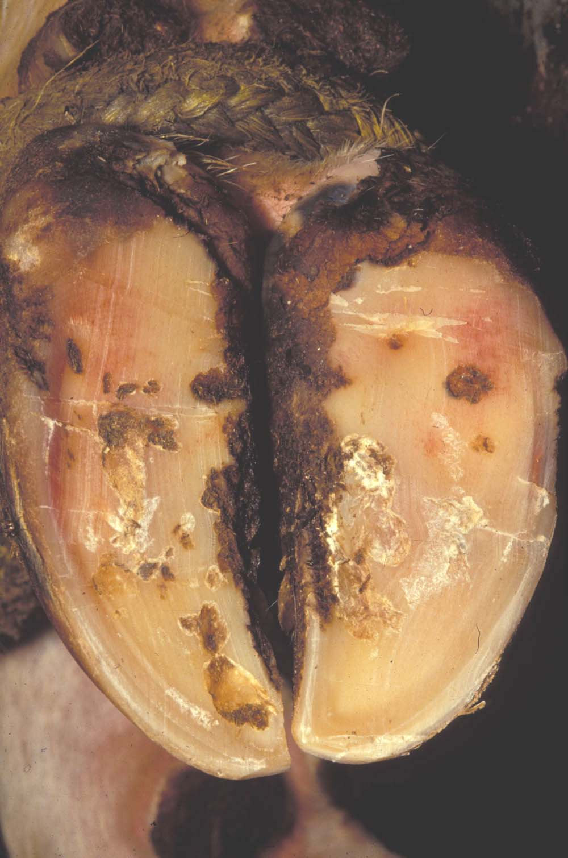

Slide 8
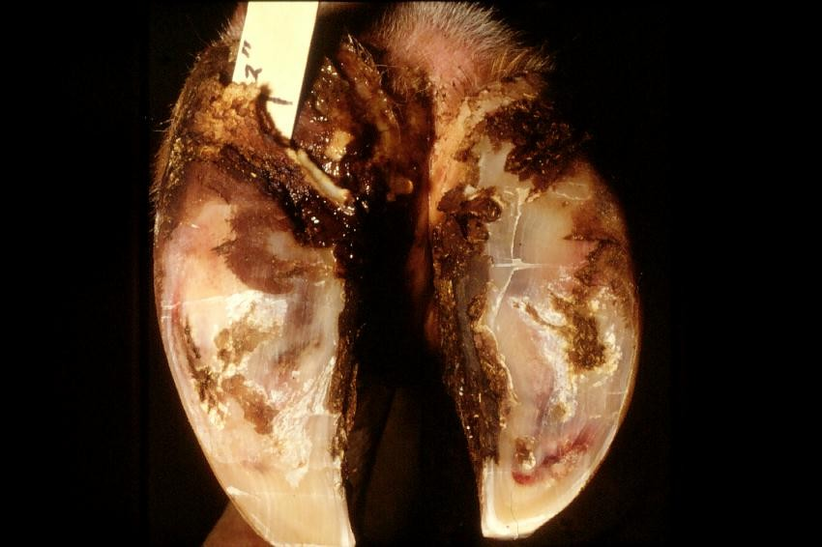
Under-run Sole and Hemorrhage

Slide 9
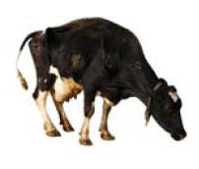
Acute Laminitis
Roached back
Obviously sore feet
Extremely reluctant to walk

Slide 10
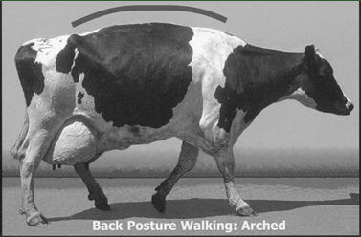
Laminitis in Dairy Cattle
Laminitis: Inflammation of the laminar corium of the hoof wall and the sole corium
Notes:
laminar corium corium of the sensitive laminae of the hoof. Bears laminae which interdigitate with lamellae of the hoof wall. Supplies nutrition to the horn and to the white zone of interlamellar horn.

Slide 11
Laminitis in Dairy Cattle

Slide 12
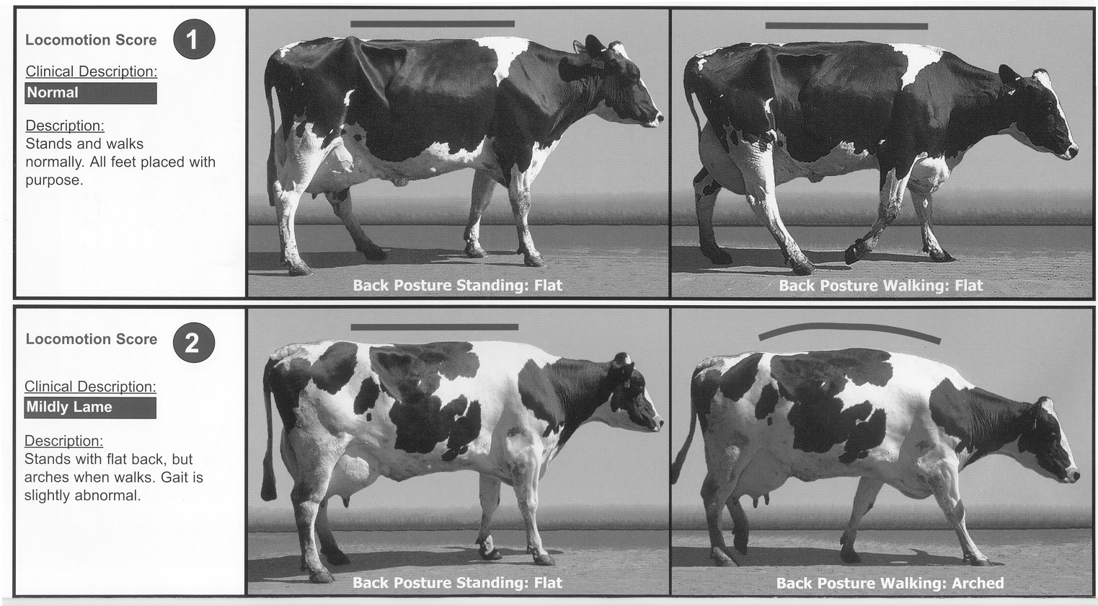
Locomotion Scoring
ZINPRO Corp.

Slide 13
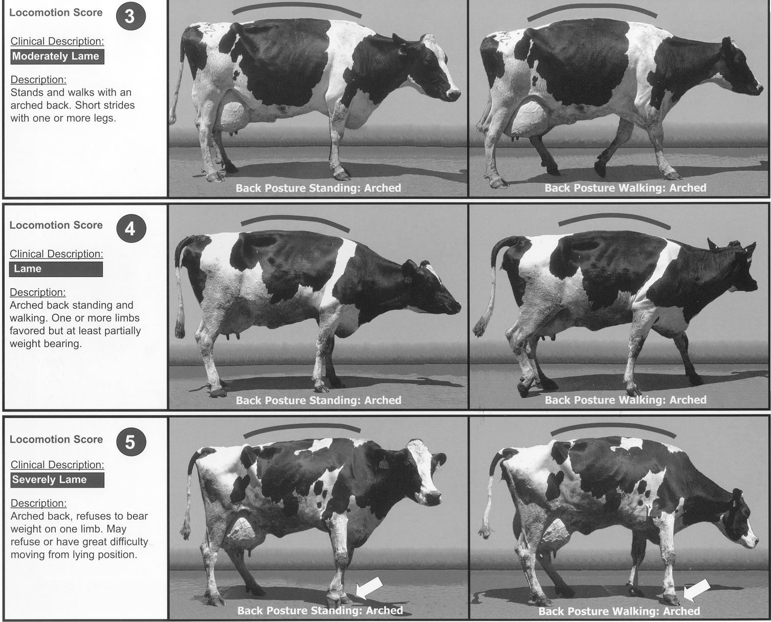

Slide 14
Significance of Locomotion Scores
Cows with a locomotion score > 2
2.8 times more likely to have increased days to first service
15.6 times more likely to have increased days open
9.0 times more likely to have more services per conception
8.4 times more likely to be culled than herdmates
________________________________________
Sprecher, et al., Theriogenology, 1997, 47:1179-1187.

Slide 15
Impact of Lameness on Culling
NAHMS, USDA 1996
15% of culling because of lameness
Additional impact on milk yield, and reproduction.
Estimated that indirect effects of lameness contribute to another 49% of culls

Slide 16
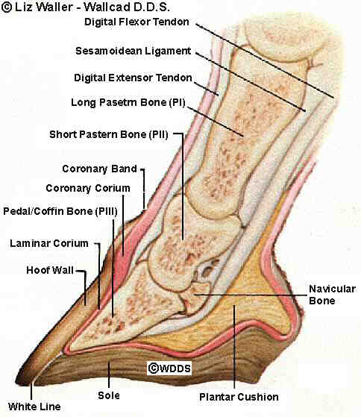

Slide 17
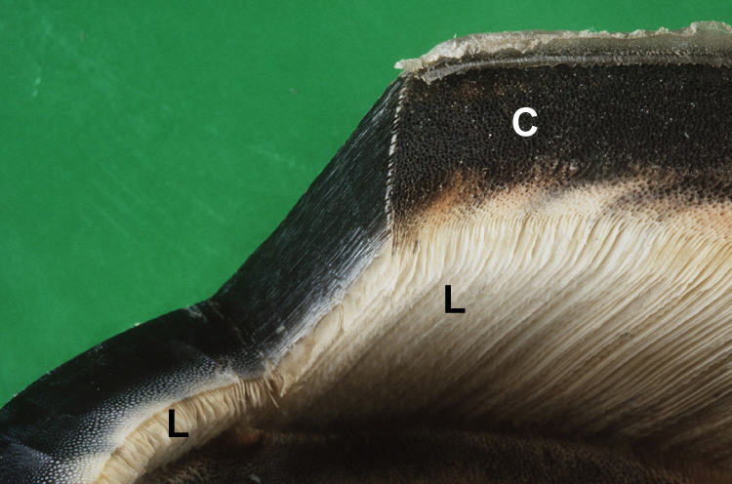
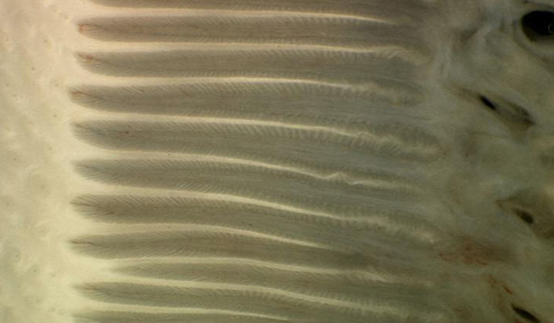
Horse pedal bone “hangs”in the lamellae

Slide 18
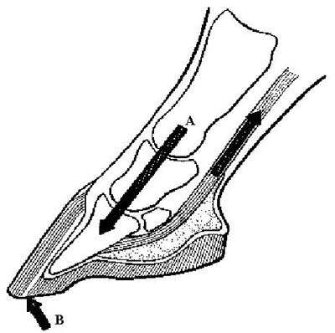
Laminitis in the Horse

Slide 19
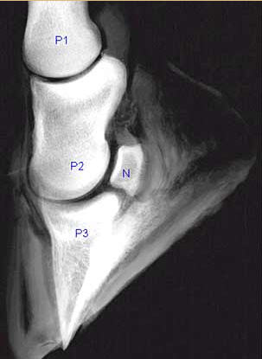

Slide 20
A Cow is Not a Horse
Notes:
Note perioplic corium at the coronary band

Slide 21
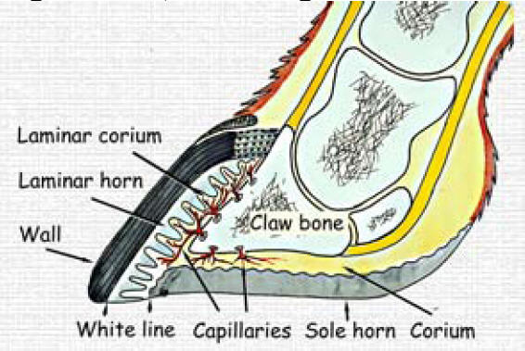

Slide 22
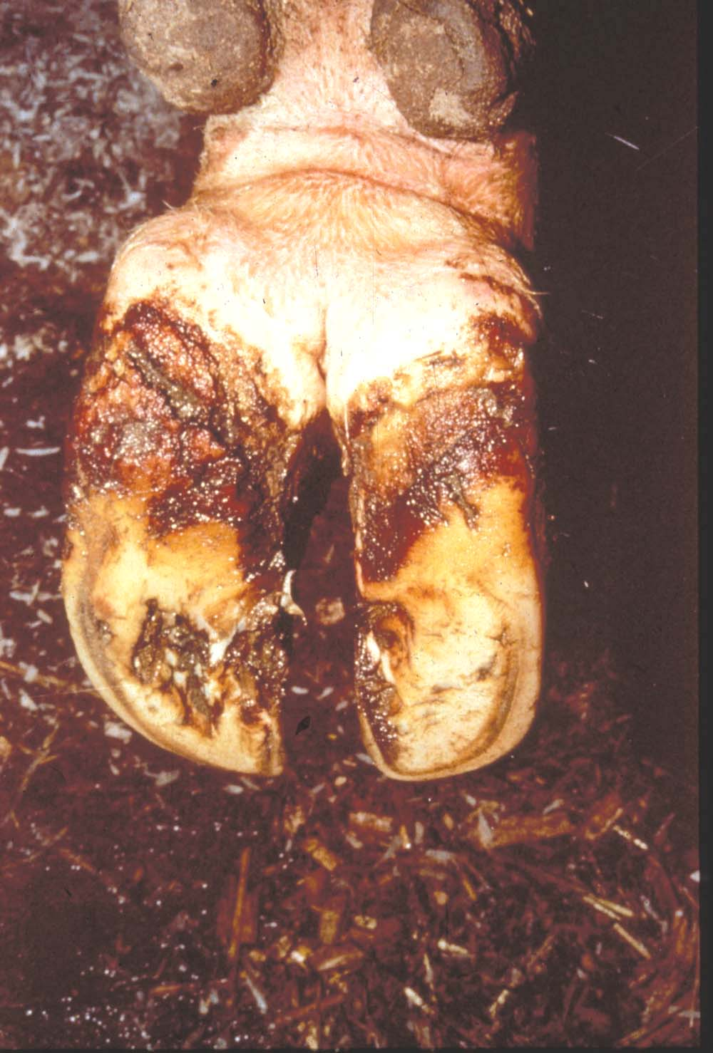
Notes:
Heel erosion

Slide 23
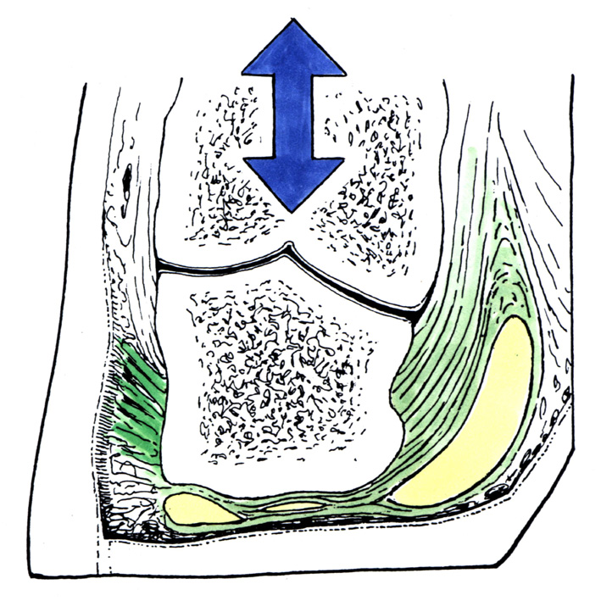
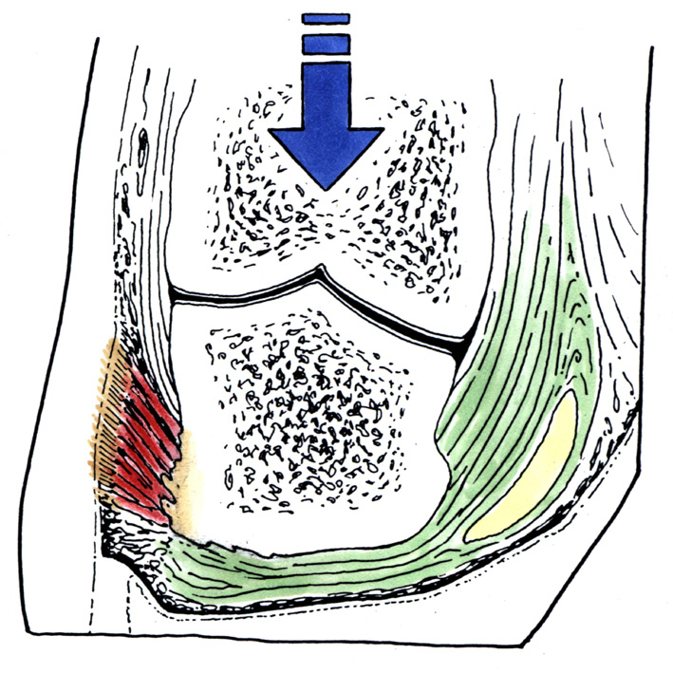
Bovine Suspensory Apparatus
P3 fixed supported by digital cushion and suspended by bundles of collagen fibers
attached to the basement layer of the abaxial wall. If fibers stretch P3 sinks and
Deforms and compresses the sole.
From Lischer & Ossent, 2007

Slide 24
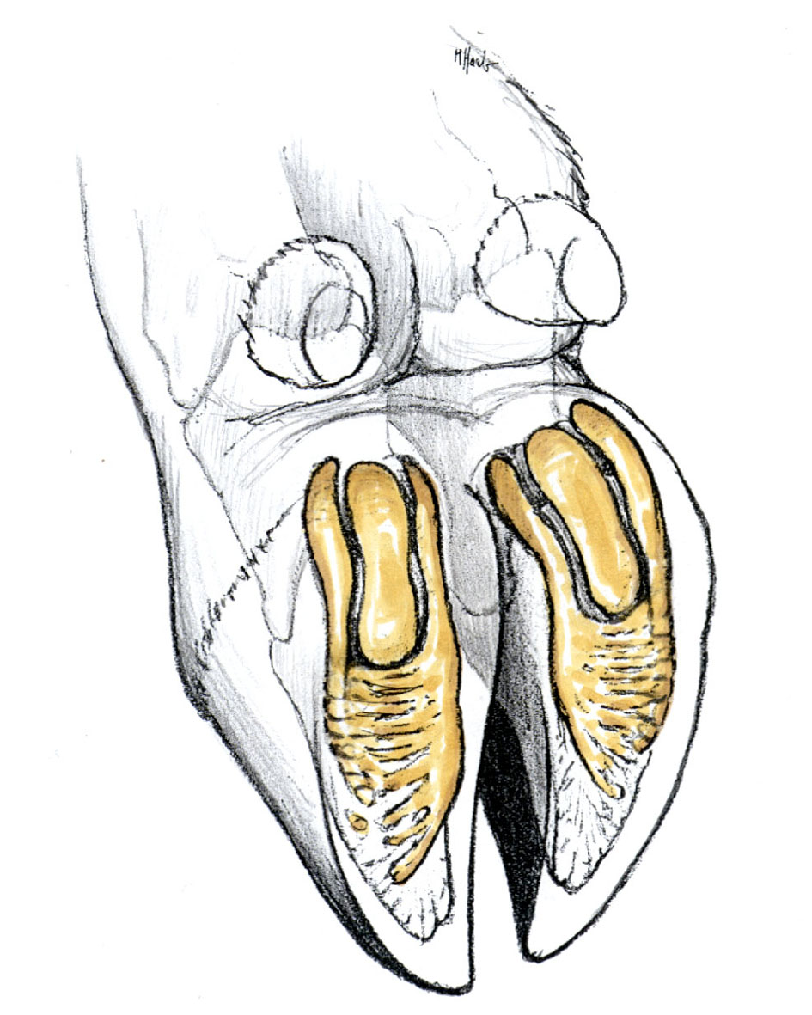
Effects of Laminitis and Sinkage of P₃ on the Digital Cushion
From Lischer & Ossent, 2007.

Slide 25
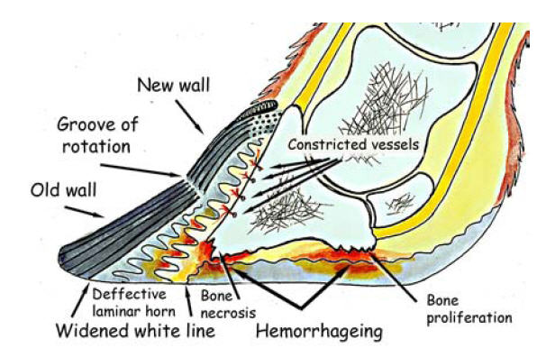
From Bergsten, 2004

Slide 26
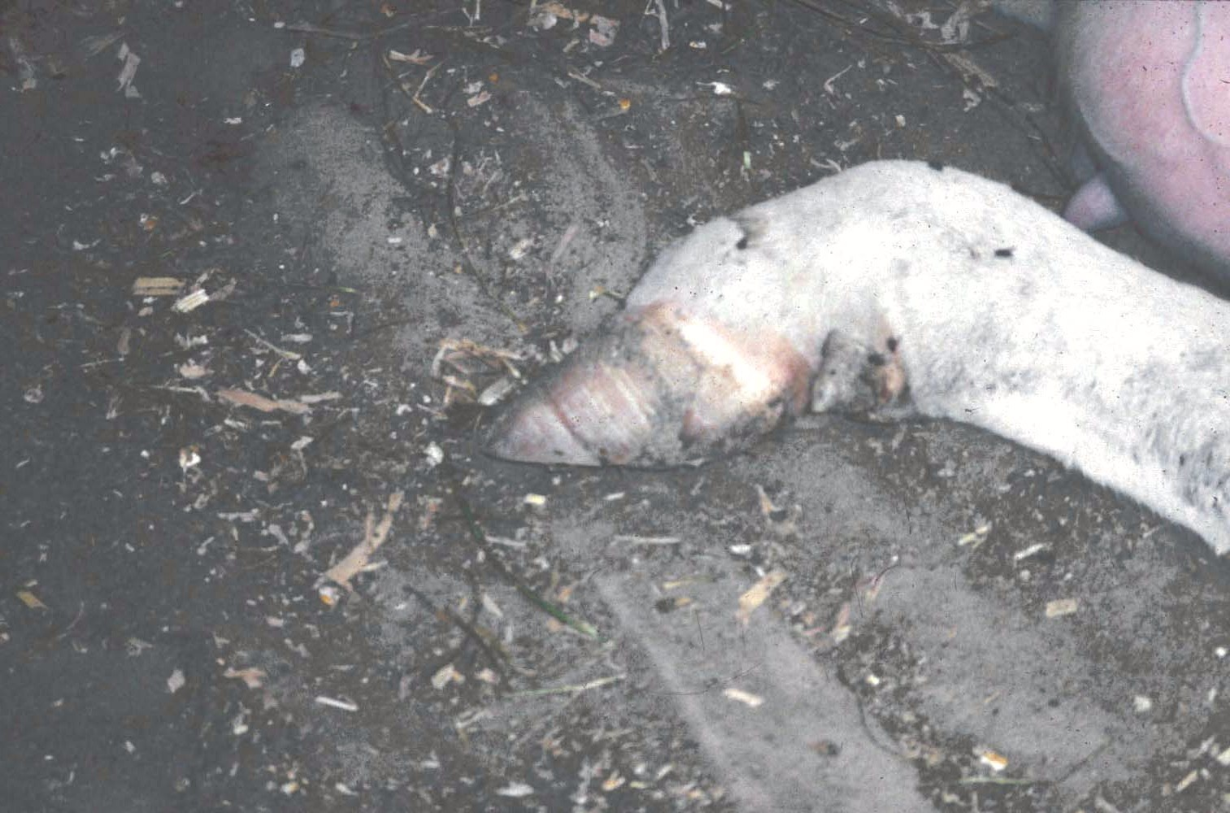

Slide 27
Risk Factors in the Cow
Nutritional i.e. rumen acidosis
Calving
Compression and pressure effects on the digital cushion
Thinning of the sole
Mechanical stress on the foot
Uneven wear

Slide 28
Dairy Nutrition
Maximize dry matter intake
Maximize energy intake
Preserve rumen health
Protect the transition cow

Slide 29
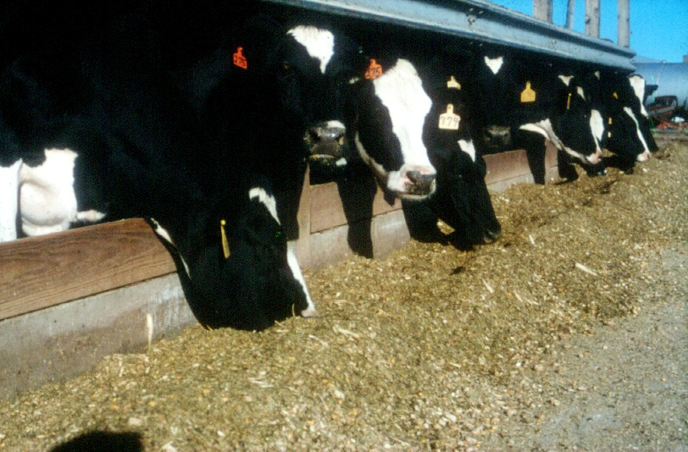

Slide 30
Energy& Fiber Constraints
Percent of Ration Dry Matter

Slide 31
Forage : Concentrate Ratio
Hay:Grain

Slide 32
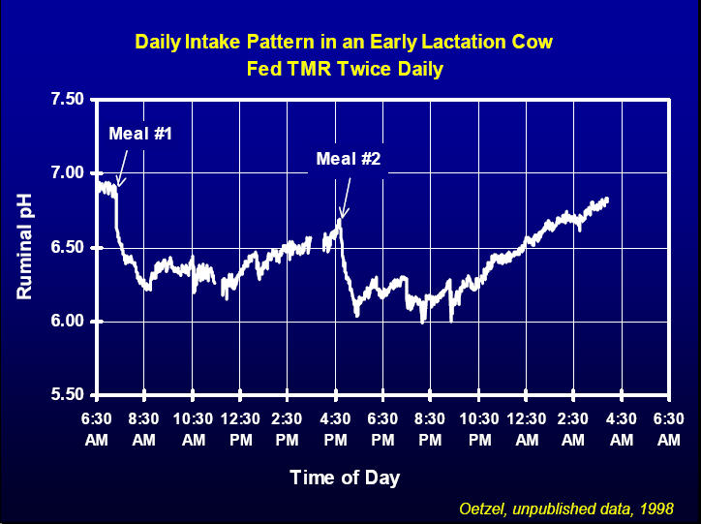

Slide 33
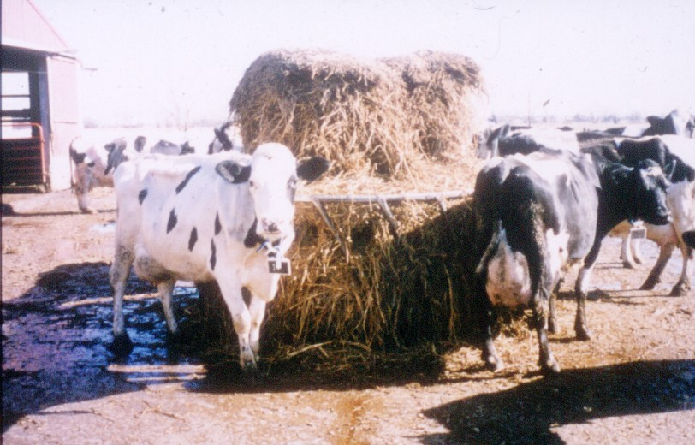

Slide 34
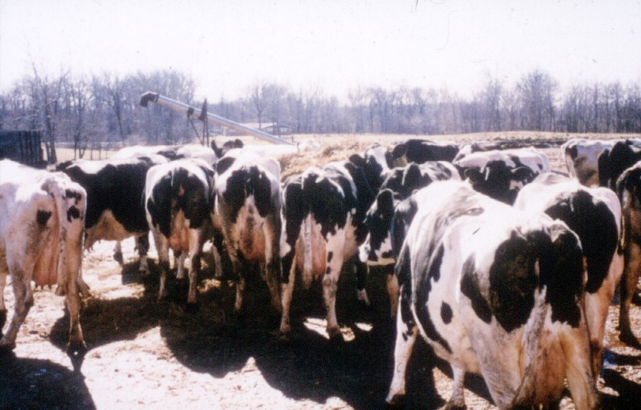

Slide 35
Cow Time Management
3-5 hours eating
9 – 14 meals
48,080 chews (10% of energy use)
7 – 10 hours ruminating
30 minutes drinking
2-3 hours milking
Needs 10 hours of lying/resting

Slide 36
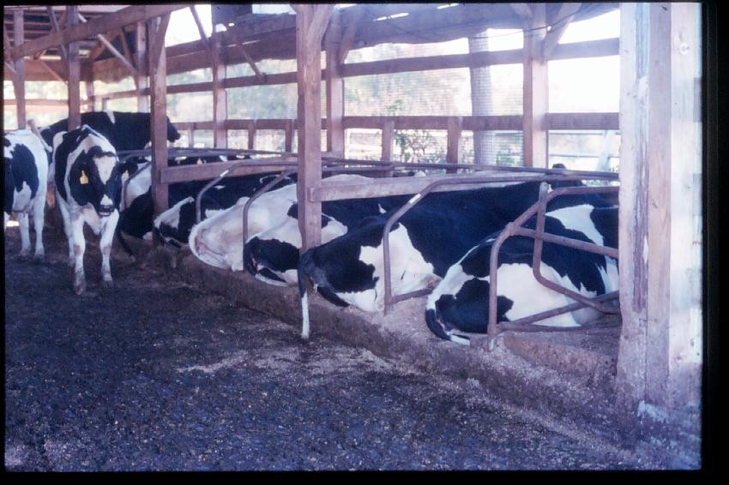
Freestall comfort

Slide 37
Mattresses
Resilient
Well bedded
Knee test

Slide 38
Free Stall Use

Slide 39
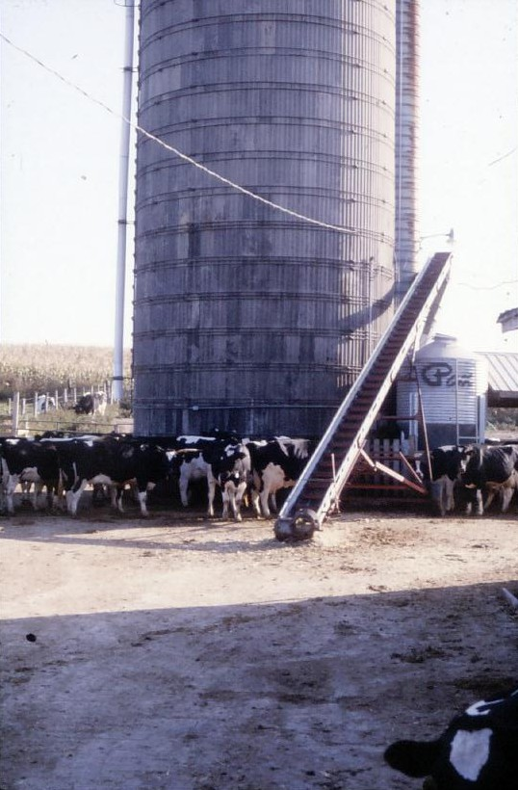

Slide 40
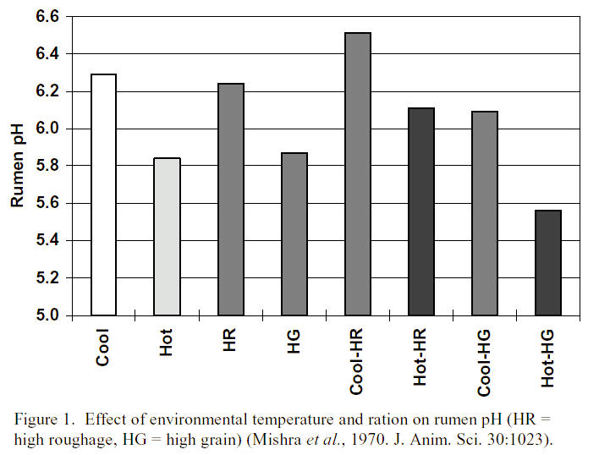

Slide 41
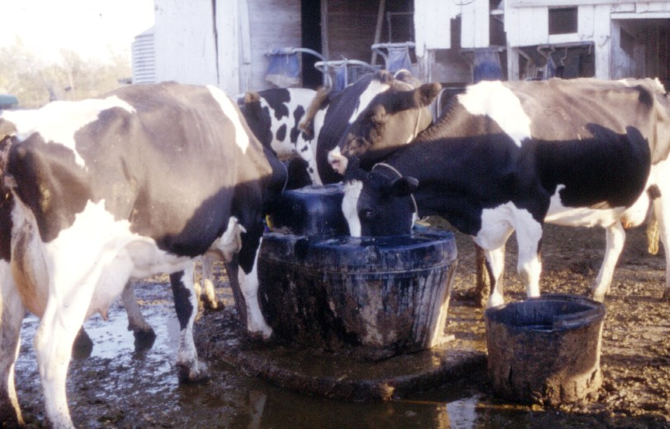

Slide 42
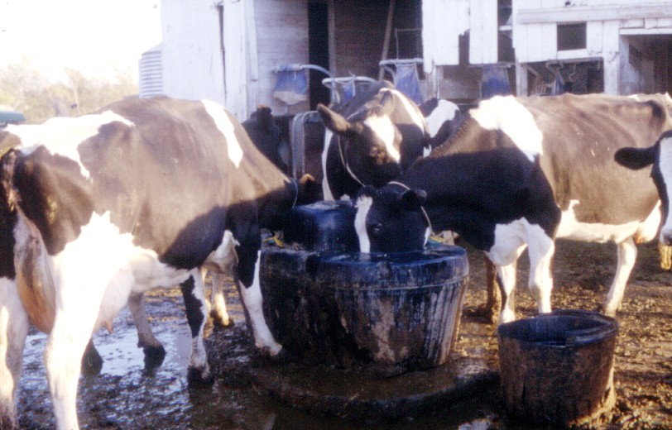

Slide 45
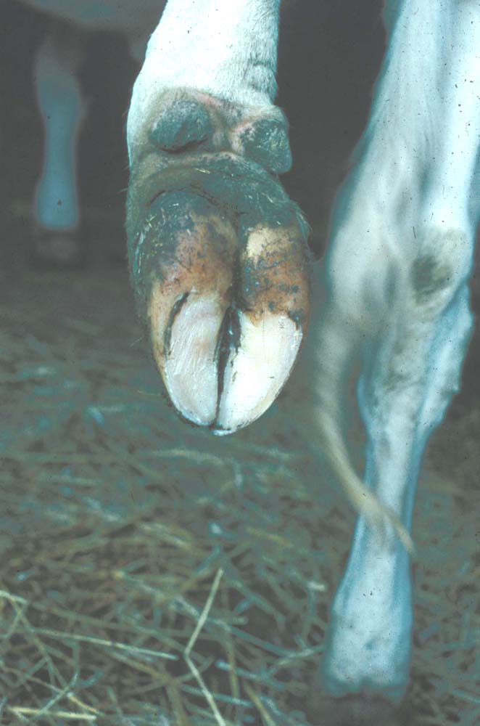
Notes:
20 month old heifer with sub-clinical laminitis

Slide 46
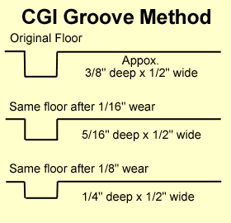
Flooring
Green concrete very abrasive
Grooving
Scrabbling
Rubber mats

Slide 47
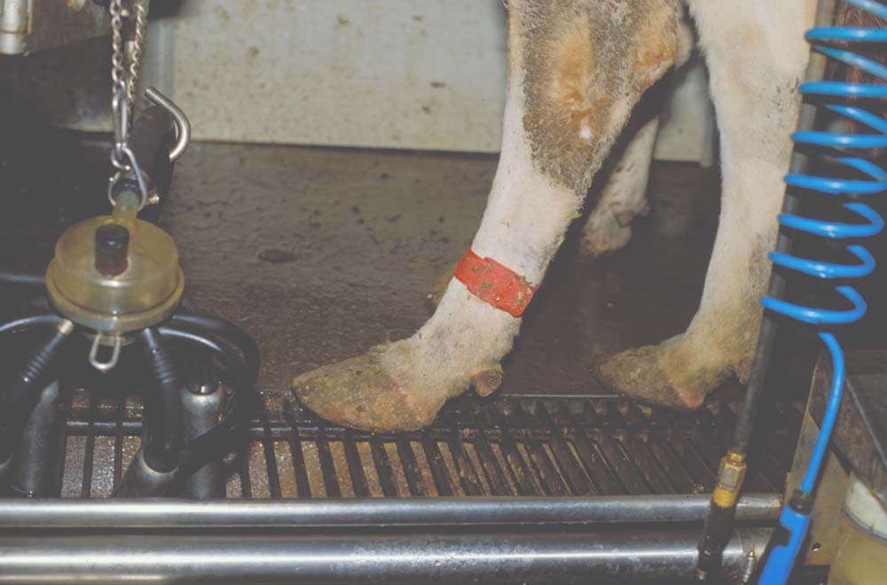

Slide 48
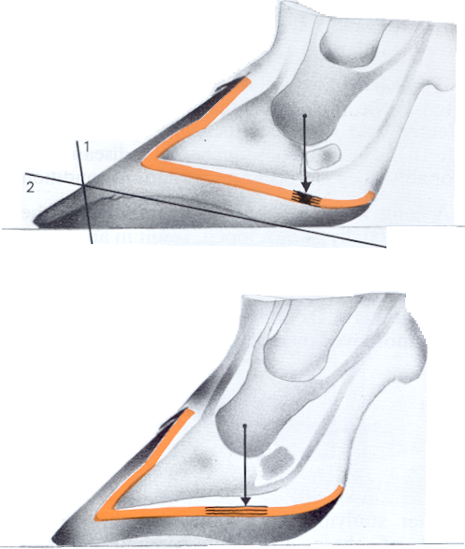
T. Raven, Cattle Footcare
and Claw Trimming, 1989.

Slide 49
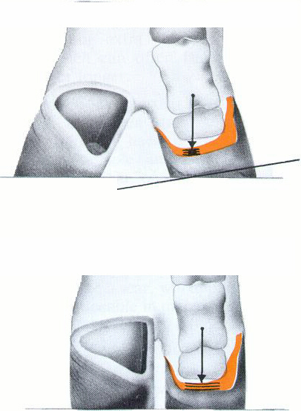
T. Raven, Cattle Footcare
and Claw Trimming, 1989.

Slide 50
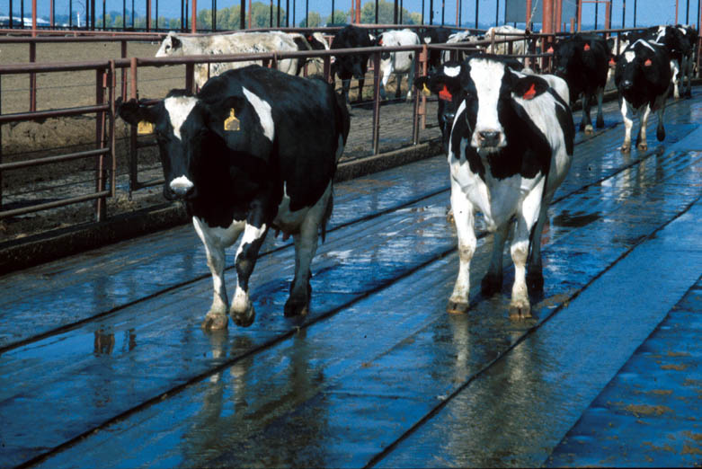

Slide 51
