Slide 1
Musculoskeletal 2
Kenyon

Slide 2
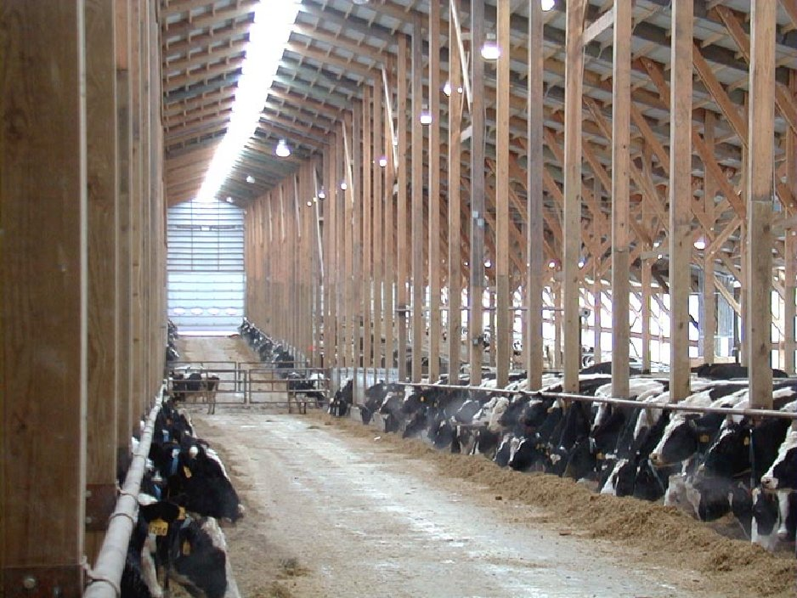

Slide 3
Diseases of the hoof skin
Digital dermatitis – hairy heel warts
Interdigital necrobacillosis –phlegmon, foul in the foot, foot rot
Interdigital skin hyperplasia – corns
(Interdigital dermatitis) and (verrucose dermatitis) – both probably the same as digital dermatitis
Notes:
Diseases of the hoof are mostly a result of management defects

Slide 4
Infectious pododermatitis

Slide 5
Digital dermatitis

Slide 6
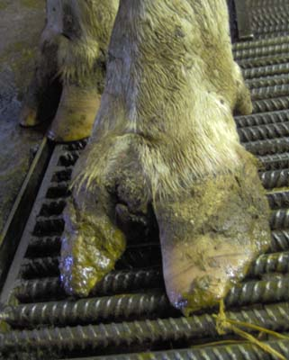
Digital dermatitis
Notes:
Aka

Slide 7
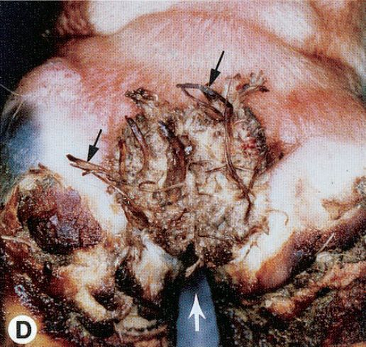
Read & Walker J Vet Diagn Invest 10:67–76 (1998)

Slide 8
Read & Walker J Vet Diagn Invest 10:67–76 (1998)

Slide 9
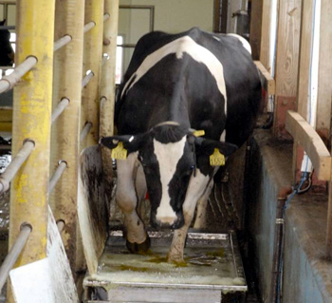

Slide 10
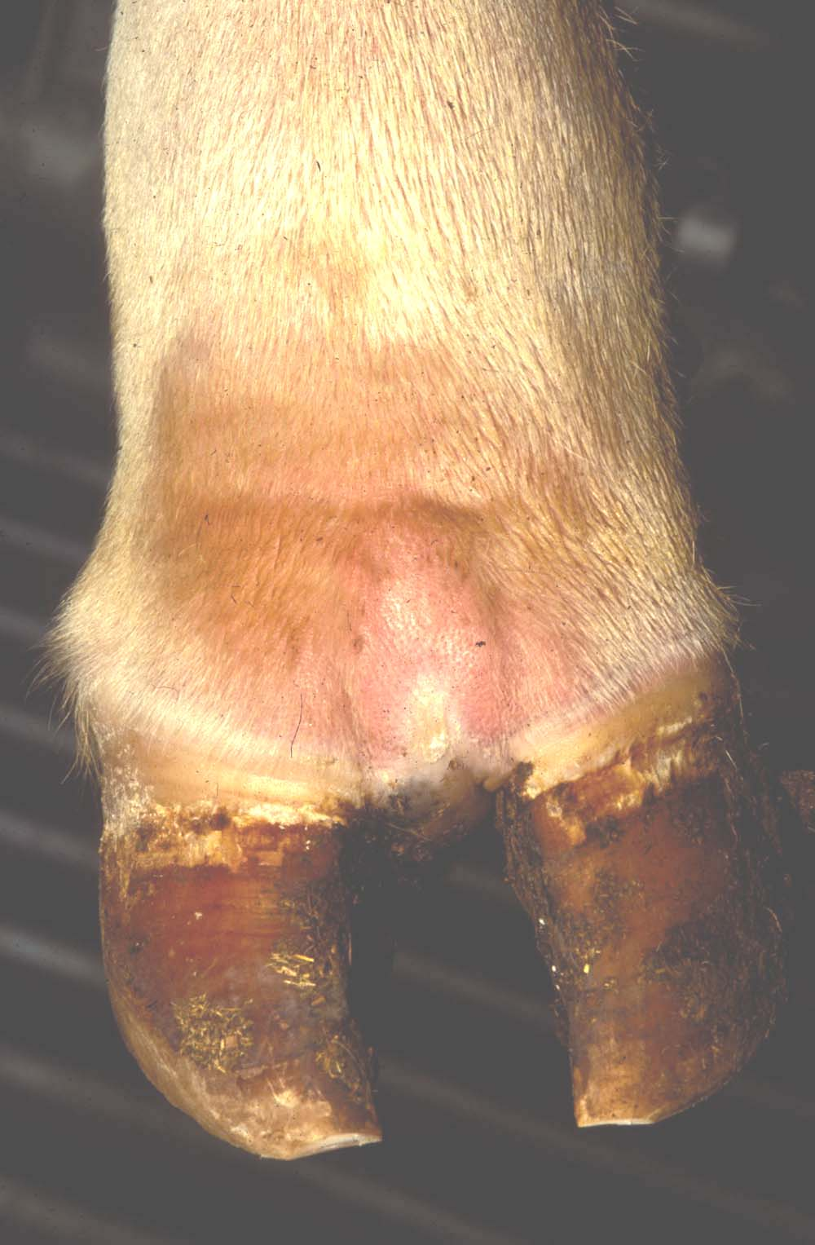
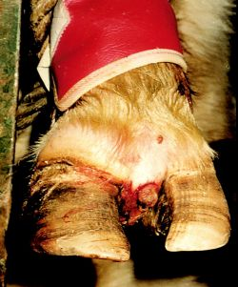
Soft tissue inflammation Septic arthritis

Slide 11
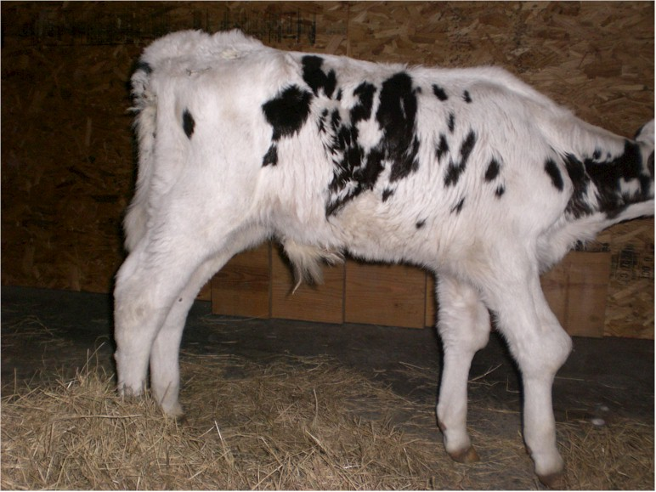
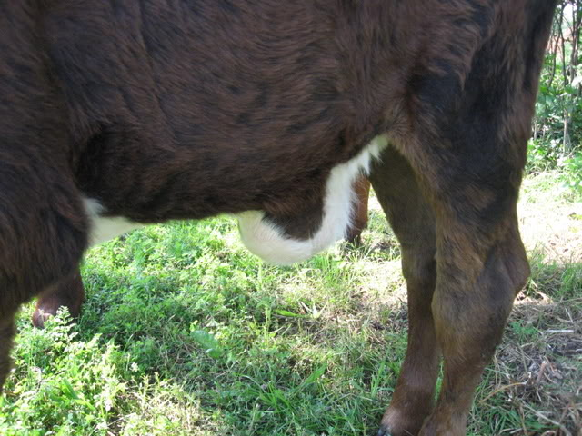

Slide 12
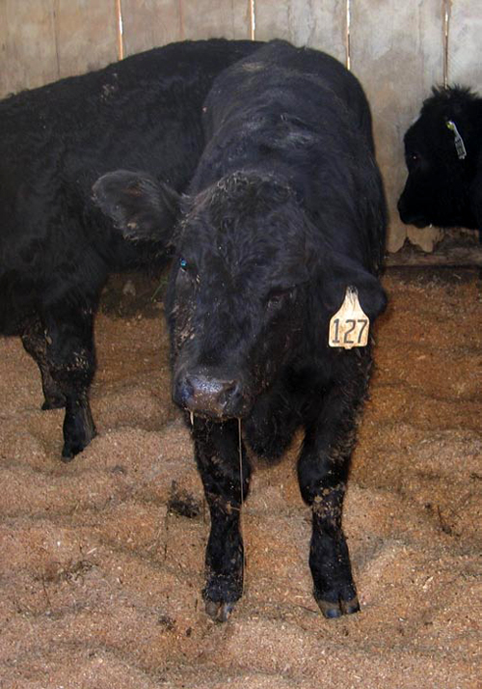

Slide 13
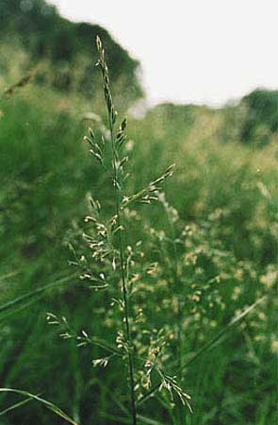
Fescue foot
Notes:
Endophyte is highest concentration in the seeds and lower leaf sheath. 90% of tall fescue is endophyte infested.
Send 15 stems to the lab – pull, don’t cut

Slide 14
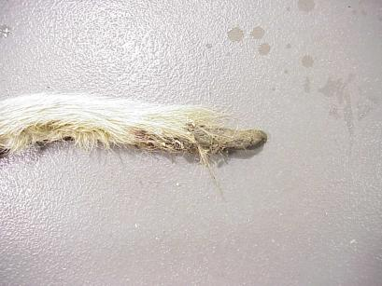
Fescue foot
Refer also to “summer slump” (epidemic hyperthermia)

Slide 15
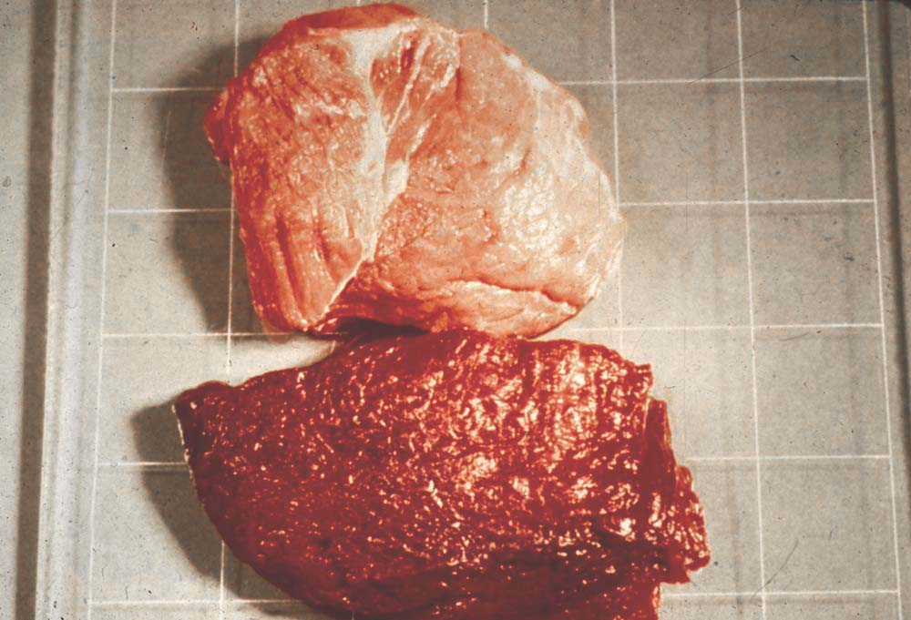
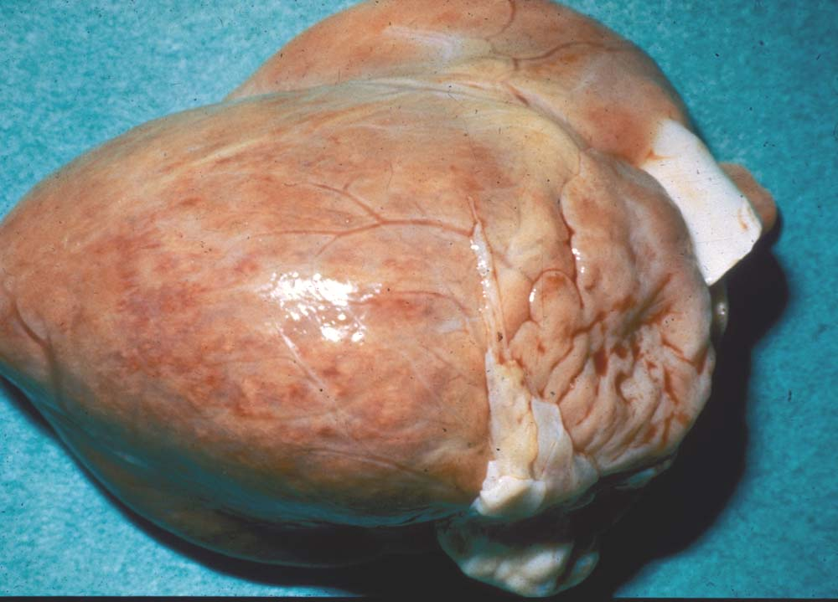
Enzootic nutritional myopathy
(White Muscle Disease)

Slide 16
Notes:
Calves frequently shows signs of NMD after exercise

Slide 18
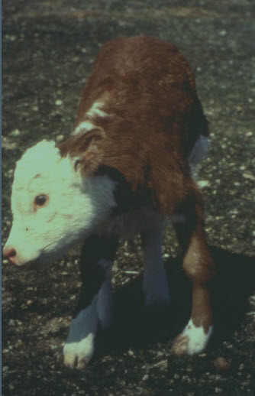

Slide 19
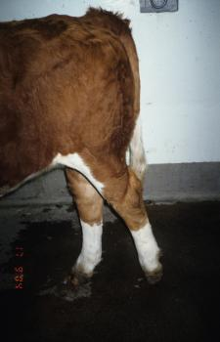
Spastic paresis
Notes:
Spastic paresis

Slide 20
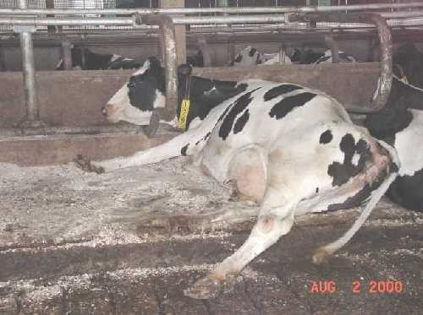
Hygromata
Neil Anderson, OMAFRA
FAO pic

Slide 22
Stifle injury

Slide 23
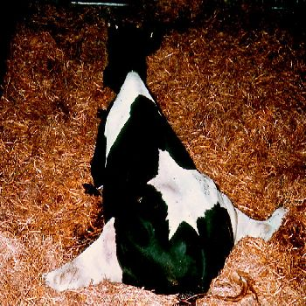
Obturator and Sciatic Nerve Injury

Slide 24
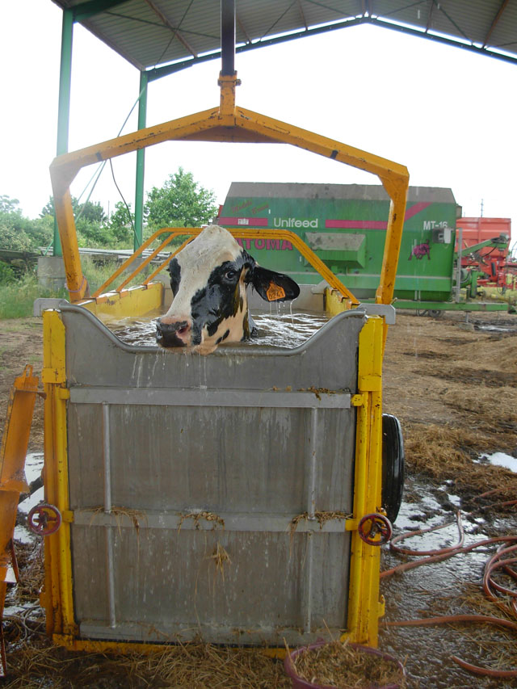
Cow lift devices
Aqua Cow
Slings

Slide 26
Coxofemoral luxation

Slide 27
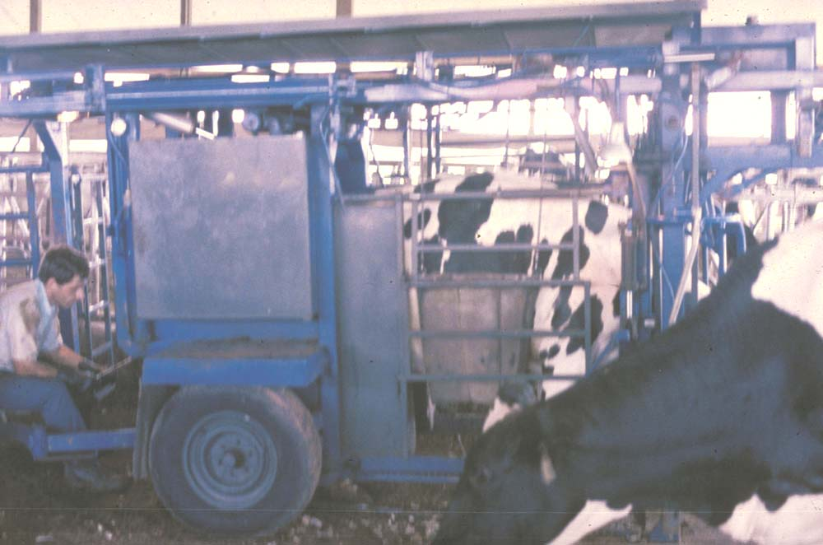

Slide 29
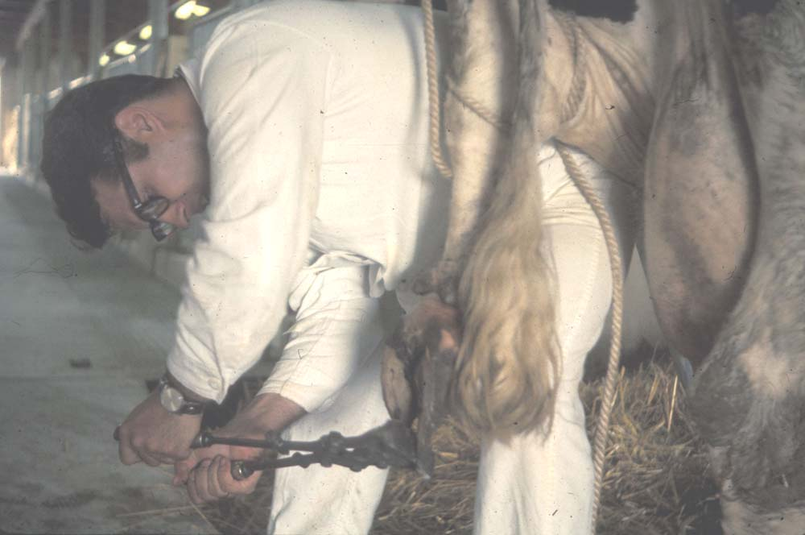
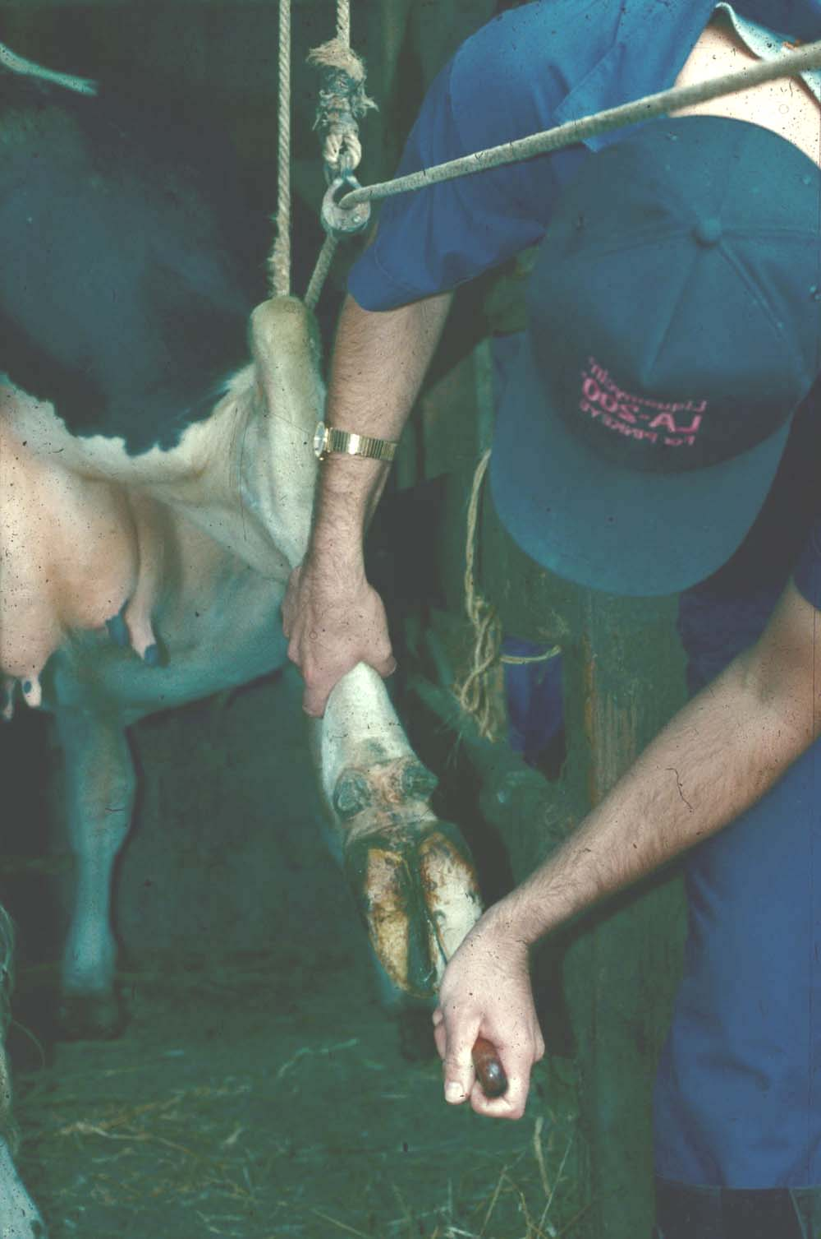

Slide 30
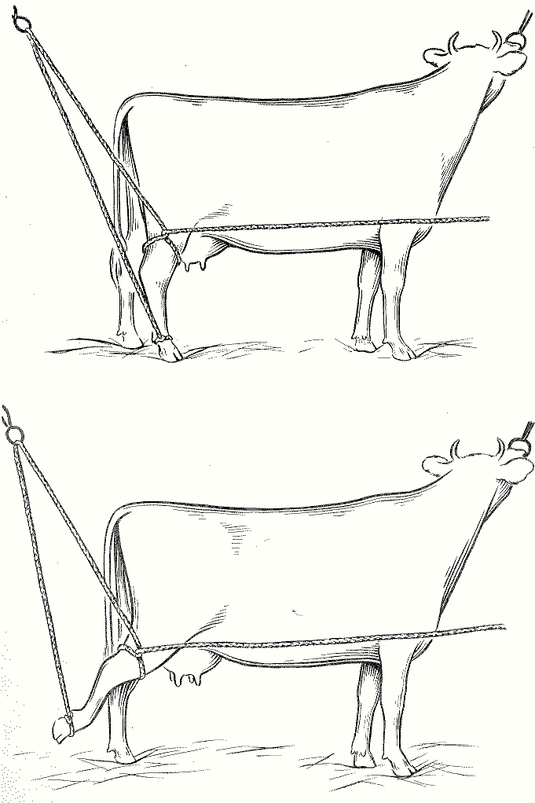

Slide 31
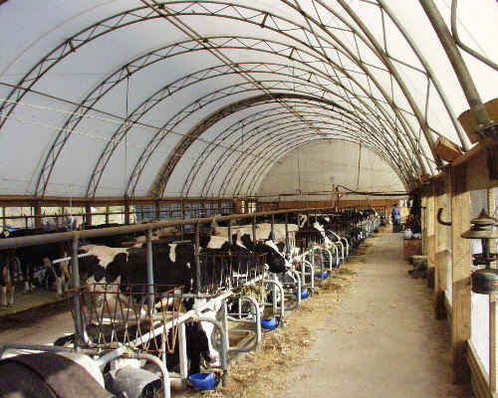
Coverall Barn

